Slide 2
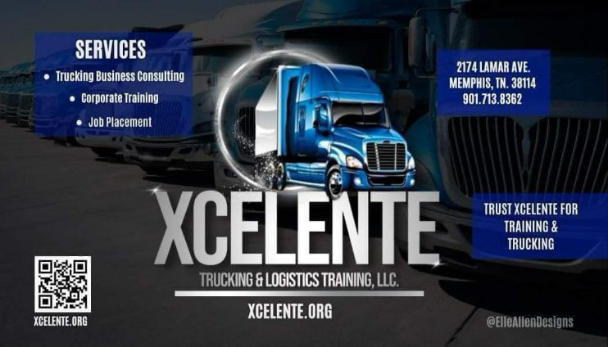
Training and Building Our Professional Truck Driving Workforce

Slide 3
Xcelente Trucking & Logistics Training Center
We are Federal and State of Tennessee Registered Commercial Driver License Apprenticeship Program
CDL training stands for Commercial Driver’s License training. It’s a specialized program designed to prepare individuals for obtaining their CDL license, which is necessary for driving commercial trucks.
XCELENTE students will always EXCEL!

Slide 4
How are commercial trucking crashes different than other types of motor-vehicle accidents?
When a crash with a commercial truck ends in property damage, injuries, or even death, the resulting insurance claim is typically more complicated, with more people, companies, insurance adjusters, and government agencies involved. The owner of the truck, the driver, the insurer, and all regulatory and licensing agencies play a part in the personal injury or wrongful death claim that will provide financial compensation for anyone injured or killed due to the negligent actions of a commercial truck driver or company

Slide 5
Memphis commercial truck accidents are a safety and legal issue for residents and visitors
Truckers are a growing motorist group using Tennessee’s highways, and commercial trucking accidents occur regularly in the Memphis region. When a truck crash happens, serious injuries and fatalities are a common result.
These behaviors by either a commercial trucker or a passenger-vehicle driver result in injury and fatality accidents on Memphis roadways regularly.

Slide 6
Common causes of commercial truck accidents in Memphis According to IIHS, a large percentage of trucking crashes are caused by:
Speeding;
Tailgating;
Improper lane changes;
Fatigued driving;
Reckless driving;
Driving while impaired
Distracted Drivers

Slide 7
At Xcelente Trucking & Logistics Training Center classroom-based CDL training plays a vital role in creating responsible, safety-conscious drivers who contribute to a safer driving environment for everyone.

Slide 8
Learning Commercial Driver License (CDL) safety in the classroom is crucial for several reasons:
Essential Skills and Knowledge:
CDL training programs provide structured learning that covers road rules, defensive driving techniques, and safety practices.
Classroom instruction ensures that aspiring drivers understand traffic laws, vehicle handling, and emergency procedures.
Internalizing Road Safety Values:
Beyond memorizing rules, classroom training helps individuals internalize values of road safety and courtesy.
Students learn to respect other road users, follow regulations, and prioritize safety.
Minimizing Accidents:
Well-informed drivers are less likely to make critical errors that lead to accidents.
Classroom education emphasizes safe practices, reducing the risk of collisions.
4. Promoting Responsible Behavior:
Classroom discussions cover topics like distracted driving, impaired driving, and fatigue management.
Drivers learn about their responsibilities and the impact of their actions on others.
5. Standardized Assessments:
Certifications and licenses assess a driver’s knowledge and skills.
CDLs ensure that commercial drivers meet specific requirements for handling large vehicles safely.
6. Preventing Unqualified Drivers:
Licensing ensures that only qualified individuals operate commercial vehicles.
Untrained or inexperienced drivers pose risks to themselves and others on the road.

Slide 9
Training and Building the Professional Truck Driver Workforce
ct

Slide 10
Professional truck drivers are the backbone of the transportation industry. They play a pivotal role in ensuring goods reach consumers efficiently and on time. However, the industry has been hand-to-hand struggle with a persistent challenge—The Shortage of Qualified Drivers.

Slide 11
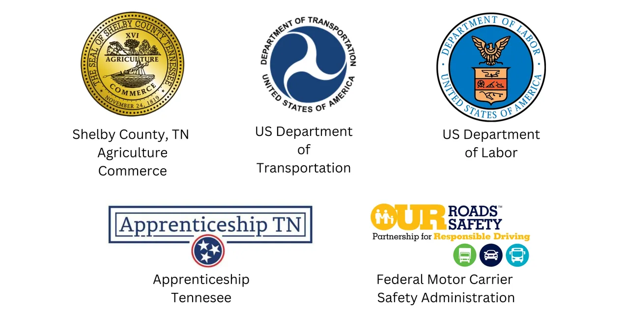
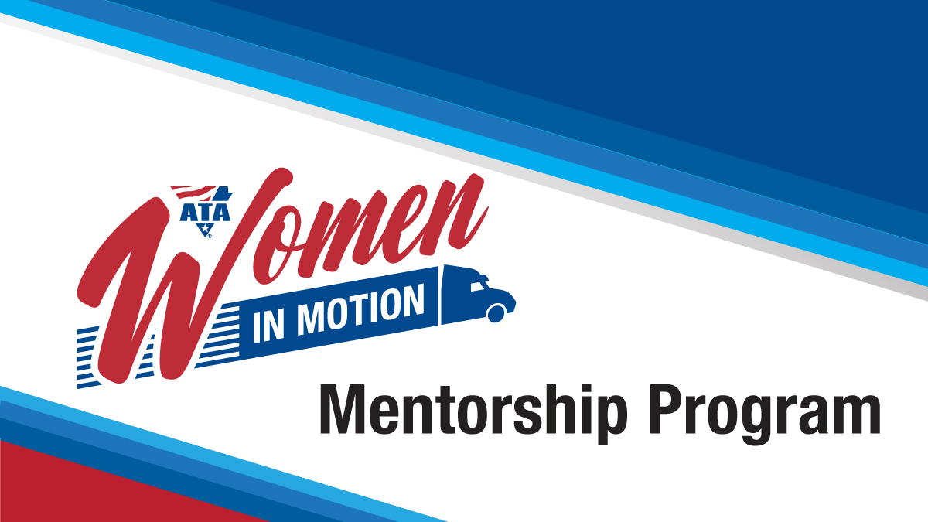
Training and Building the Professional Truck Driver Workforce
Xcelente Trucking is creating a movement of training highly qualified drivers to meet the growing demand of the transportation industry.
Our instructors are expert teachers with experience in trucking. We create a supportive learning atmosphere.
We are a proven resource for new and growing trucking businesses and those wanting to excel in trucking.
Our business partnerships with employers and other supportive agencies allow us to help change lives in our community

Slide 12
FMSCA Safe Driver Apprenticeship Pilot Program.
SDAP Apprenticeship Program is for youth ages 18- 20 years who currently holds a CDL license can train over the road with an approved FMSCA SDAP Training Provider.

Slide 13
Our 1st Youth Driver who was recruited for the SDAP Apprenticeship Program is now an Over The Road Truck Driver

Slide 14
Crash, Prevention, Reduction metrics
Impact factor | Measurement | CPR | Achieved
CDL Graduate | Percentage (100%) | 0 | 100%
Post-Graduation/ Follow-Up | 100% | 0 | 100%

Slide 15
Resource & Data
Motor vehicle collisions are a major public safety issue in Tennessee. The Governor’s Traffic Safety Office provides a high-quality map with information on the data and statistics related accidents across the state. The Tennessee Department of Transportation provides the latest updates in traffic safety and road information for the state. We provide our students with these resources during classroom training to assist them with planning for the road ahead.

Slide 16
Final tips & takeaways

Slide 17
Thank you
Xcelente Trucking & Logistics Training Center
1840 Pyramid Place
Memphis, Tennessee 38132
866-923-5368

