Slide 1
Crash Prevention & Reduction
Chattanooga Area
2024 Safety Coalition Meeting
Captain Allen England | April 25, 2024

Slide 2
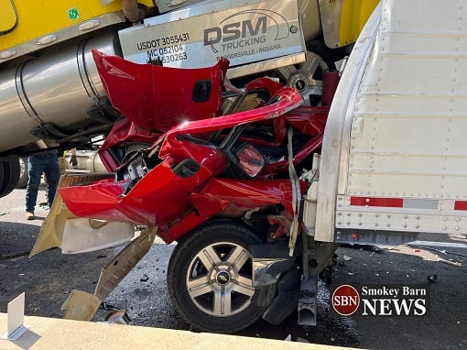
Crash Problem

Slide 3
Think Tank - 2019

Slide 4
CMV Crash Reduction Collaborative Meeting
February 11, 2020

Slide 5
Participants
Federal Highway Administration
Federal Motor Carrier Safety Administration
Tennessee Department of Transportation
Tennessee Highway Patrol
Tennessee Highway Safety Office
Tennessee Road Builders Association
Tennessee Trucking Association
Tennessee Trucking Foundation / Tennessee Road Team Captains

Slide 6
Task
Name for the coalition

Slide 7
NYPD Blue

Slide 8
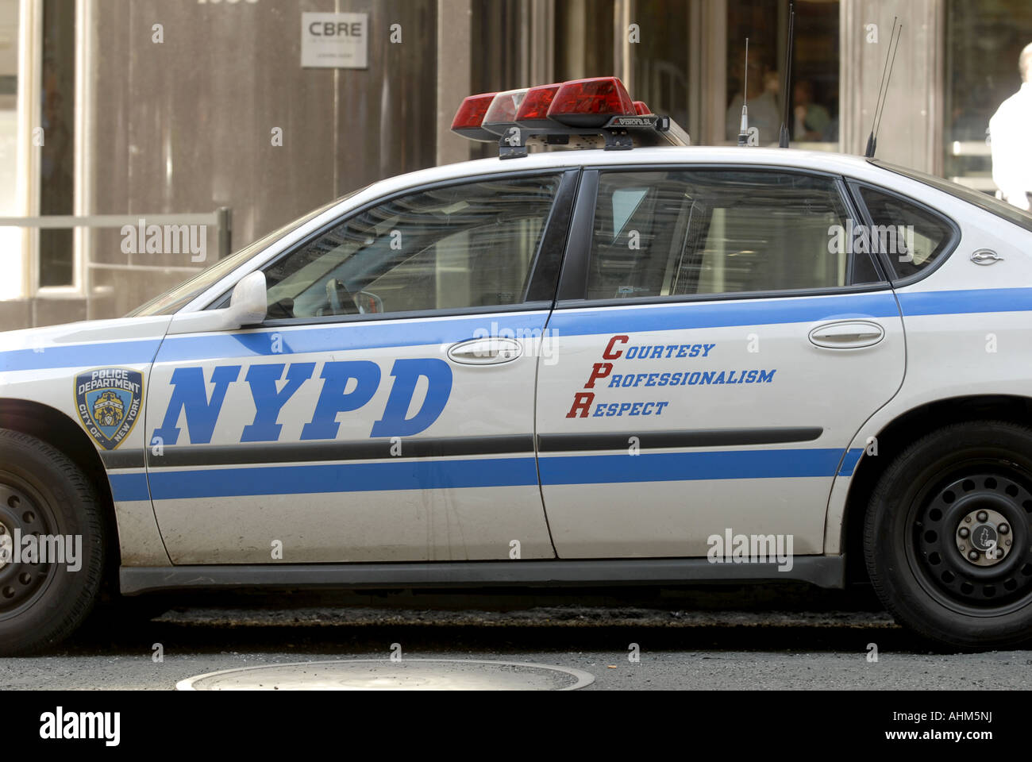
C.P.R. Crash Prevention & Reduction

Slide 10
Contact Information
Allen England | Captain
Tennessee Highway Patrol MC+
Commercial Vehicle-Pupil Transportation
1150 Foster Avenue, Nashville, TN 37243
p. (615) 743-4973
Allen.England@tn.gov

