Slide 1
Georgia Department of Public Safety Motor Carrier Compliance Division

Slide 2
Captain Dawn Arrowood​
Region A Commander ​
Georgia Department of Public Safety​
Motor Carrier Compliance Division
Georgia Department of Public Safety Motor Carrier Compliance Division

Slide 3
Georgia Department of Public Safety
Three Law Enforcement Divisions
Georgia State Patrol
Motor Carrier Compliance Division
Capitol Police Division
The primary focus of the Motor Carrier Compliance Division is commercial driver and vehicle safety and the protection of our state’s highway infrastructure.
Georgia Department of Public Safety Motor Carrier Compliance Division

Slide 4
Motor Carrier Compliance Division
MCCD:
Overview
Enforcement Details
Dangerous Driver Behavior
CMV-Involved Crash Trends
Statewide
Region A – North GA Area
Outreach
Georgia Department of Public Safety Motor Carrier Compliance Division

Slide 5
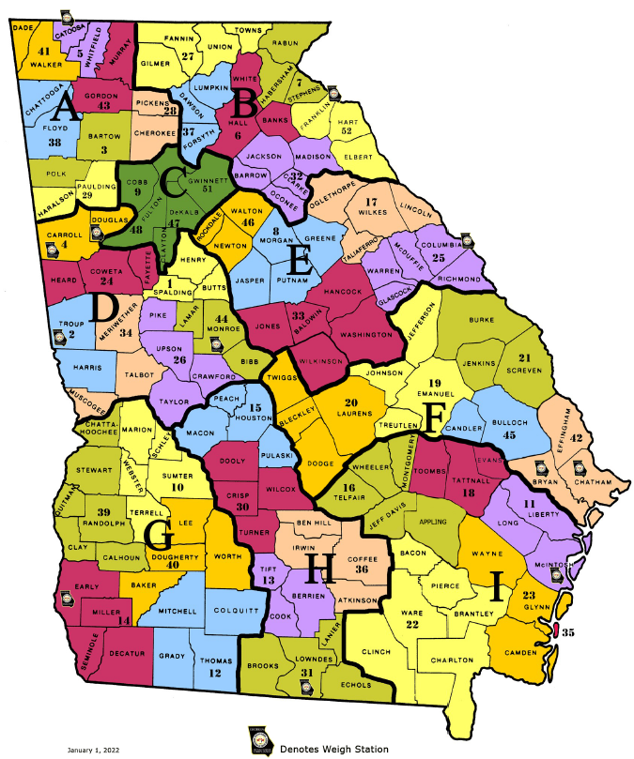
DPS
Troop and Region
Map
*Updates
Region A: Capt. Arrowood (404) 304-4161
Region B: Capt. Cook (706) 556-8044
Region C: Capt. Pilcher (404) 624-7077
Region D: Capt. Hodo (404) 357-7813
Region E: Capt. Hackney (404) 670-7878
Region F: Capt. Deloach (404) 858-1724
Region G: Capt. Sample (404) 624-7212
Region H: Capt. Byrd (229) 441-1331
Region I: Capt. Hall (912) 832-3458
Georgia Department of Public Safety Motor Carrier Compliance Division

Slide 6
MCCD Responsibilities
Enforcement of Commercial Vehicle Regulations
Traffic Enforcement on CMVs
Compliance Reviews and Safety Audits on Motor Carriers
Enforcement of Size & Weight Laws
School Bus Safety Inspections
Post-Crash Inspections
Hazard Material Inspections
Georgia Department of Public Safety Motor Carrier Compliance Division

Slide 7
Region A Personnel Assignments
20 Personnel
18 NAS Certified
20 Size & Weight
12 Cargo Tank Certified
2 Enhanced RAM Certified
2 Motor Coach Certified
12 Hazmat Certified
7 FTO's
1 Peer Support
2 IT Power Users
1 Phlebotomist
3 Training Instructors
1 Detached to Training
Georgia Department of Public Safety Motor Carrier Compliance Division

Slide 8
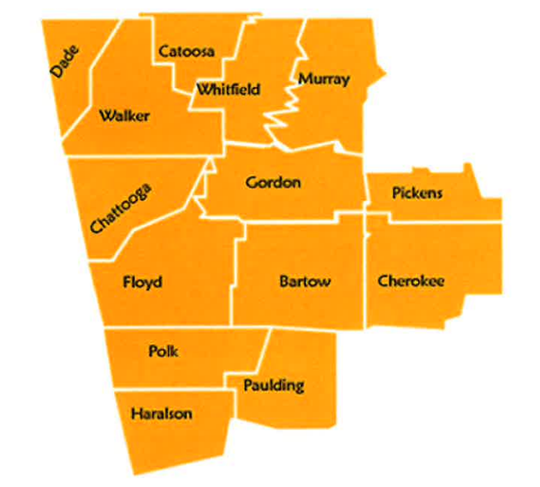
Region A Covers 14 Counties​
2 CO’s​
4 NCO’s​
15 Officers​
2 Weight Inspectors​
1 Administrative Assistant
Georgia Department of Public Safety Motor Carrier Compliance Division

Slide 9
Topics Discussed
High Crash Corridors​
Top Causation Factors​
Top Days of the Week and Times for Crashes​
Top Violations for CMVs Noted
Georgia Department of Public Safety Motor Carrier Compliance Division

Slide 10
Region A Statistics for 2023
8,719 Inspections
43 DUI Drugs or Alcohol related arrests
116 Total arrests
482 Drivers placed OOS
987 Vehicles placed OOS
1,132 Total traffic violations
2,483 Citations
4,837 Warnings
Georgia Department of Public Safety Motor Carrier Compliance Division

Slide 11
Crash Trends
Georgia Department of Public Safety Motor Carrier Compliance Division

Slide 12
Crash Data in Law Enforcement
When crashes are happening:
Days of the week
Time of day
Where crashes are happening:
Counties
Roadways
Important factors:
Causative factors
Driver factors
=
When to schedule resources
=
Where to deploy resources
=
What actions and behaviors to focus on
Georgia Department of Public Safety Motor Carrier Compliance Division

Slide 13
Crash Numbers
Total Number of Crashes-1,002
Total Number of Fatal Crashes-13
14 total Fatalities
*Crash Data from July 1st 2023 to December 31st 2023
Georgia Department of Public Safety Motor Carrier Compliance Division

Slide 14
High Crash Corridors
CMV Crashes By County
Bartow – 275
Whitfield – 132
Cherokee – 117
Gordon – 99
Catoosa - 85
Georgia Department of Public Safety Motor Carrier Compliance Division

Slide 15
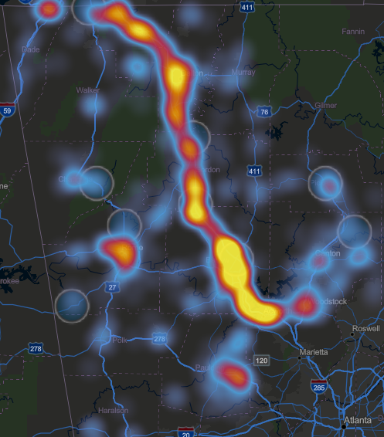
High Crash Corridors
Region A Crash Hot Spots
Region A Fatal Crash Locations
Georgia Department of Public Safety Motor Carrier Compliance Division

Slide 16
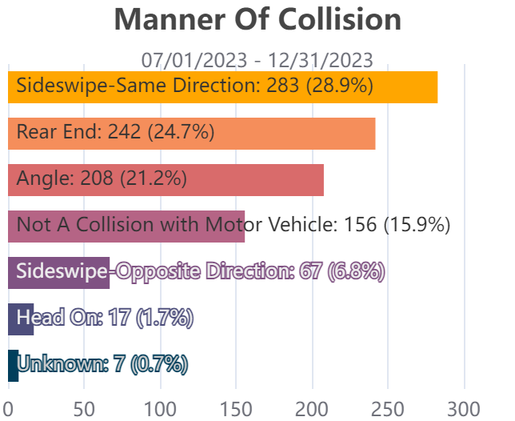
Top Crash Causation Factors
CMV Crash Causation Factors
Fatal Crash Causation Factors
Georgia Department of Public Safety Motor Carrier Compliance Division

Slide 17
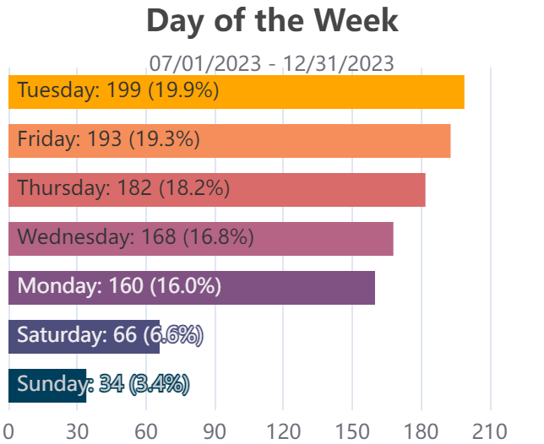
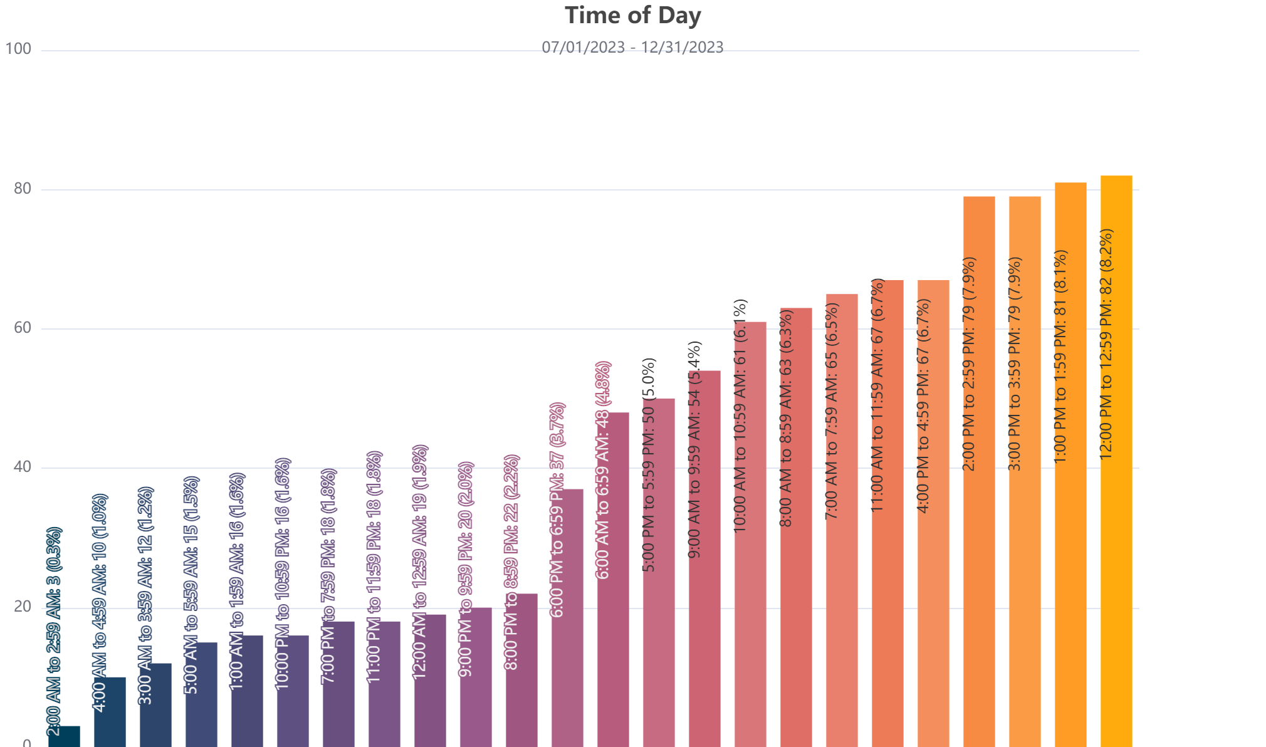
Crash Frequency
CMV
Crash Frequency
Georgia Department of Public Safety Motor Carrier Compliance Division

Slide 18
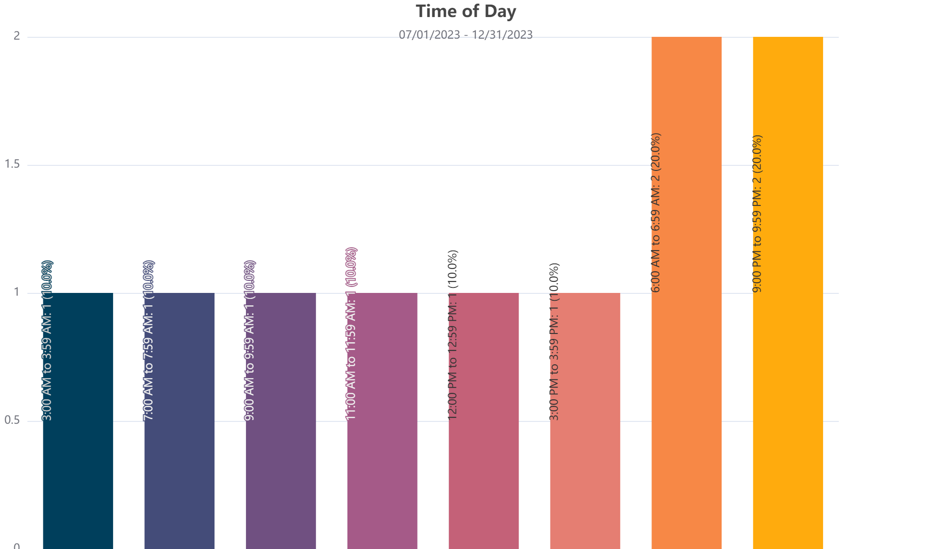
Fatal Crash Frequency
CMV
Fatal Crash Frequency
Georgia Department of Public Safety Motor Carrier Compliance Division

Slide 19
Region A CMV Involved Fatalities​
July 1st 2023 to December 31st 2023
14 Fatalities​
13 Fatal Crashes​
CMV involved At-Fault – 6​
Following Too Close ​
Following Too Close and Distracted​
Failed to Yield​
Lost Control​
Medical Event​
Hit and Run​
POV involved At-Fault - 6​
Both Parties At-Fault – 1
Georgia Department of Public Safety Motor Carrier Compliance Division

Slide 20
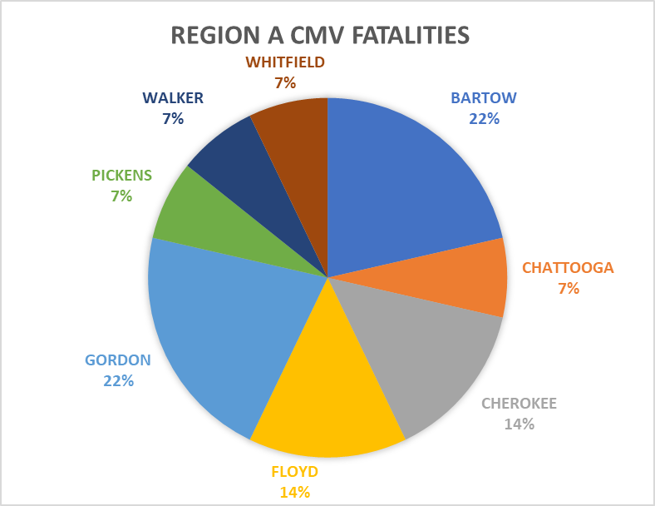
Region A Counties with Fatalities​
Bartow – 3 Fatalities​​
Chattooga – 1 Fatality​​
Cherokee – 2 Fatalities​​
Floyd – 2 Fatalities​​
Gordan – 2 Crashes (3 Fatalities)​​
Pickens – 1 Fatality​​
Walker – 1 Fatality​​
Whitfield - 1 Fatality
Georgia Department of Public Safety Motor Carrier Compliance Division

Slide 21
July 2023 – December 2023
3,839 Inspections Completed
6,393 Violations Noted
Top Violations during that time period:
Overweight/Excessive Weight Violations
Record of Duty Status Violations:395.3A2-PROP
No RODS:395.8
Not Marked with DOT Number or Company Name:390.21TB
No Annual Inspection: 396.17C
Speeding: 392.2-SLLS3
Glazing Permits: 393.60D
No Medical Certificate or Card: 391.41a1-NPH
Operating without a CDL: 383.23A2
Lane Restrictions: 392.2LV
No Tag: 40-2-8
Georgia Department of Public Safety Motor Carrier Compliance Division

Slide 22
Georgia Department of Public Safety Motor Carrier Compliance Division

Slide 23
Captain Dawn Arrowood
Region A Commander
404-304-4161
darrowood@gsp.net
Lt. Justin Conaway
Region A Assistant Commander
404-273-7680
jconaway@gsp.net
Georgia Department of Public Safety Motor Carrier Compliance Division

Slide 24
Georgia Department of Public Safety Motor Carrier Compliance Division

Slide 25
Georgia Department of Public Safety Motor Carrier Compliance Division

