Slide 1
CRASH PREVENTION & REDUCTION
CHATTANOOGA AREA
2024 SAFETY COALITION MEETING
Sgt. Jason Harris
Alabama Law Enforcement Agency
Motor Carrier Safety Unit

Slide 2
CRASH PREVENTION & REDUCTION
CHATTANOOGA AREA
Crash Identification Points to Consider
Alabama 2024 CMV Crash Stats
Alabama 2023 CMV Crash Stats

Slide 3
Crash Identification Points to Consider
Who?
What?
Where?
When?
Why?

Slide 4
Crash Identification Points to Consider
Who – Who is crashing, Non-CMV or CMV?
What?
Where?
When?
Why?
Notes:
How to identify causal unit? Crash reports, State crash data programs.

Slide 5
Crash Identification Points to Consider
Who – Who are having the crashes, Non-CMV or CMV?
What – What is the contributing circumstances?
Where?
When?
Why?
Notes:
Driver Error???????? Defective Equipment?????? From the previous slide, who caused the crash, CMV-non-CMV. The type of vehicle will determine your approach. MCSAP or Highway Patrol.

Slide 6
Crash Identification Points to Consider
Who – Who are having the crashes, Non-CMV or CMV?
What – What is the contributing circumstances?
Where – Where are the crashes occurring?
When?
Why?
Notes:
Rural/Urban, Mile posted routes (Interstate or major State roads), secondary roads, CZ’s

Slide 7
Crash Identification Points to Consider
Who – Who are having the crashes, Non-CMV or CMV?
What – What is the contributing circumstances?
Where – Where are the crashes occurring?
When – Seasonal traffic trends versus holiday, Days of week, hours?
Why?
Notes:
When. Look at the months, days and times. Associated with seasonal travel or holiday travel. Seasonal could be related to CMV traffic increase for stores stocking up for Christmas. Holiday travel with a destination point within the State or are you a travel through State for other destinations.

Slide 8
Crash Identification Points to Consider
Who – Who are having the crashes, Non-CMV or CMV?
What – What is the contributing circumstances?
Where – Where are the crashes occurring?
When – Seasonal traffic trends versus holiday, Days of week, hours?
Why – Why are the crashes occurring, economics, road construction, population, industry and/or environmental?
Notes:
New industry coming to an area, being built, opened for business. What else could be associated with the new industry, road construction, population increase/ decrease in an adjoining county. Changing of the driving environment for the local population. Possible solution, outreach.

Slide 9
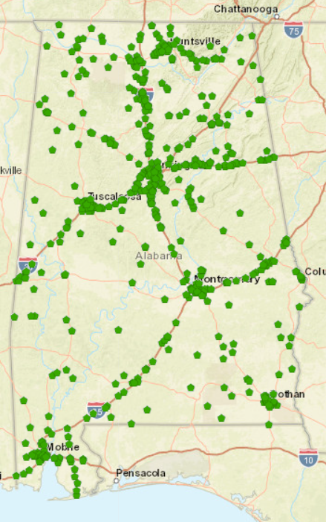
Freight Alley
2024 all CMV Crashes
932 reported
January – February 2024

Slide 10
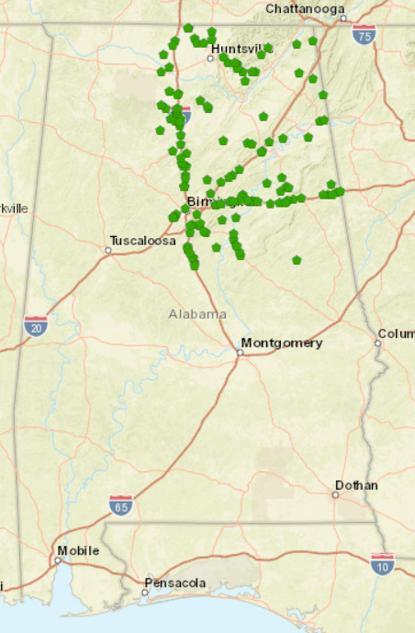
2024 Troop F & G
All CMV Crashes
January – February 2024
January – February 187 of the 932 reported
Notes:
20% of the crashes for the State – Freight Alley

Slide 11
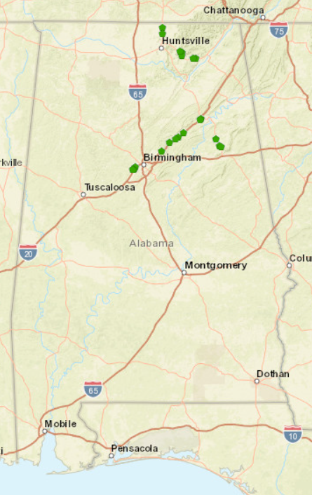
2024 Troop F & G
I-59, US-431 & US-72
January – February 2024

Slide 12
2024 Top 10 Prime Contributing Circumstances involving a CMV Troop F & G
January – February 2024
Improper Lane Change/Use | 42
Driving too Fast for Conditions | 23
Followed too Close | 11
Defective Equipment | 11
Swerved to Avoid Vehicle | 7
DUI | 6
Crossed Centerline | 6
Other - No Improper Driving | 6
Failed to Yield Right-of-Way from Stop Sign | 5
Unseen Object/Person/Vehicle | 5

Slide 13
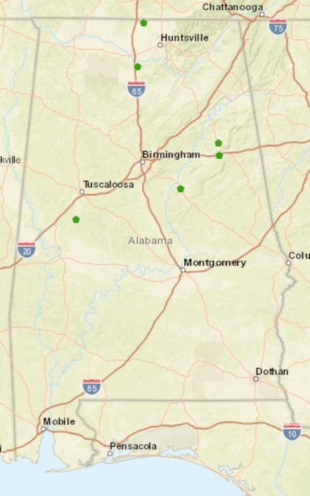
2024 Fatal CMV Crashes 7 reported
January – February 2024

Slide 14
2024 Fatal Prime Contributing Circumstances involving a CMV. January – February 2024
.
Ran Stop Sign | 1
Over Speed Limit | 1
Crossed Centerline | 1
Followed too Close | 1
Over Correcting/Over Steering | 1
Failed to Yield Right-of-Way from Stop Sign | 1
Unseen Object/Person/Vehicle | 1
Total | 7
Note : The CMV is not the contributing unit in the 7 crashes reported

Slide 15
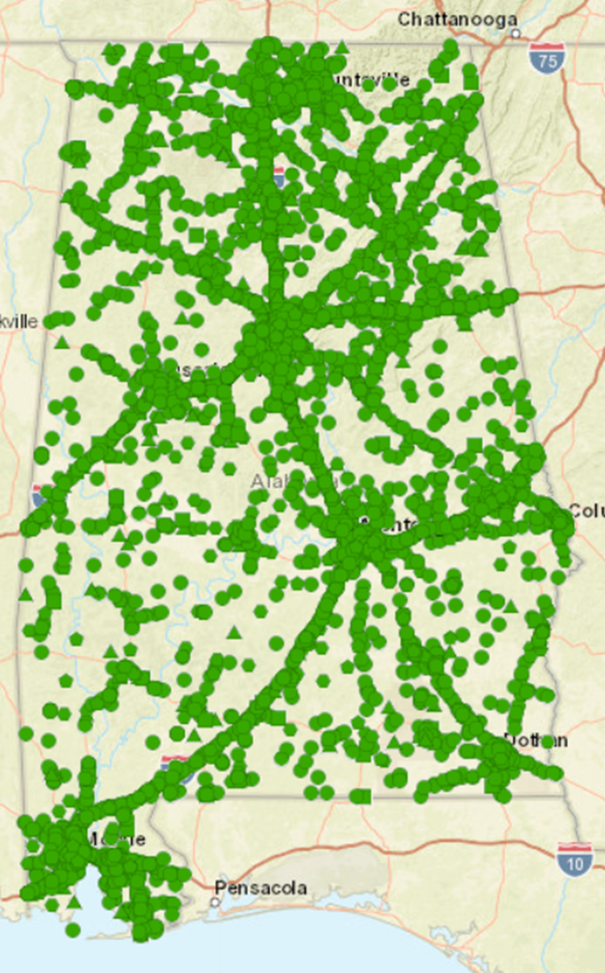
CY 2023 all CMV Crashes
8,226 reported

Slide 16
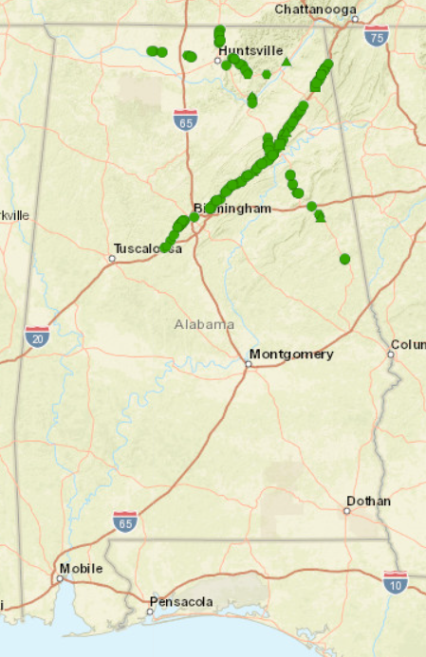
CY 2023 Troop F & G
I-59, US-431 & US-72

Slide 17
2023 Top 10 Prime Contributing Circumstances involving a CMV Troop F & G
January – February 2024
Improper Lane Change/Use | 334
Defective Equipment | 101
Followed too Close | 92
Unseen Object/Person/Vehicle | 63
E Failed to Yield Right-of-Way from Stop Sign | 46
Cargo Fell or Load Shift | 44
E Other - No Improper Driving | 42
E Crossed Centerline | 40
E Swerved to Avoid Vehicle | 39
E Fatigued/Asleep | 38
Notes:
Total Reported for F & G 1272

Slide 18
2024 Fatal Prime Contributing Circumstances involving a CMV.
Note : The CMV is not the contributing unit in the 7 crashes reported.
Ran Stop Sign | 1
Over Speed Limit | 1
Crossed Centerline | 1
Followed too Close | 1
Over Correcting/Over Steering | 1
Failed to Yield Right-of-Way from Stop Sign | 1
Unseen Object/Person/Vehicle | 1
Total | 7

Slide 19
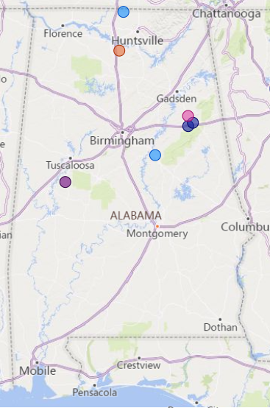
January 2024 CMV Involved Fatal Crashes
There are a total of 7 CMV involved Fatal Crashes for January 2024

Slide 20
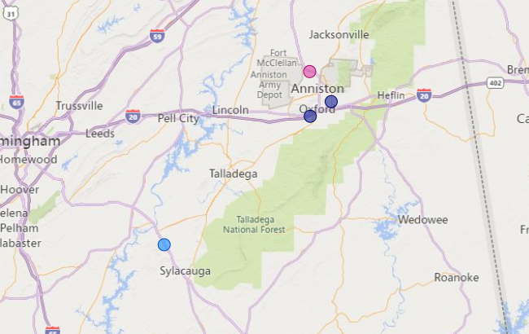
January 2024 Calhoun and Talladega County
Unseen Object/Person/Vehicle
Cross Centerline
Four Fatal Crashes involving CMV. CMV is not the CU.
Three of the Four Crashes are Rural and One Urban.
Cross Centerline
Follow Too Close

