Slide 1
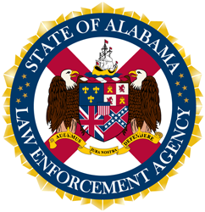
Crash Prevention and Reduction
Clearinghouse II

Slide 2
About WorkforceQA
In business for over 20 years
Full MRO / TPA
Over 800,000 tests reported annually
Industry best Post-Accident service
DOT Physical Review
Background Services
.

Slide 3
About Alabama Law Enforcement Agency
ALEA was created by the consolidation and realignment of 12 state law enforcement agencies.
Within ALEA, the Department of Public Safety includes the Driver License, Highway Patrol, and Marine Patrol Divisions.
The Driver License Division facilitates both the written and skill tests for all classes of license issued to Alabama drivers. Also maintains the records associated with the Alabama licenses including crash reports as well as driver violations/convictions.
LEADS – modernized driver license system was implemented in April 2022.
First to begin downgrades of Drug and Alcohol Clearinghouse Prohibited Drivers.
.

Slide 4
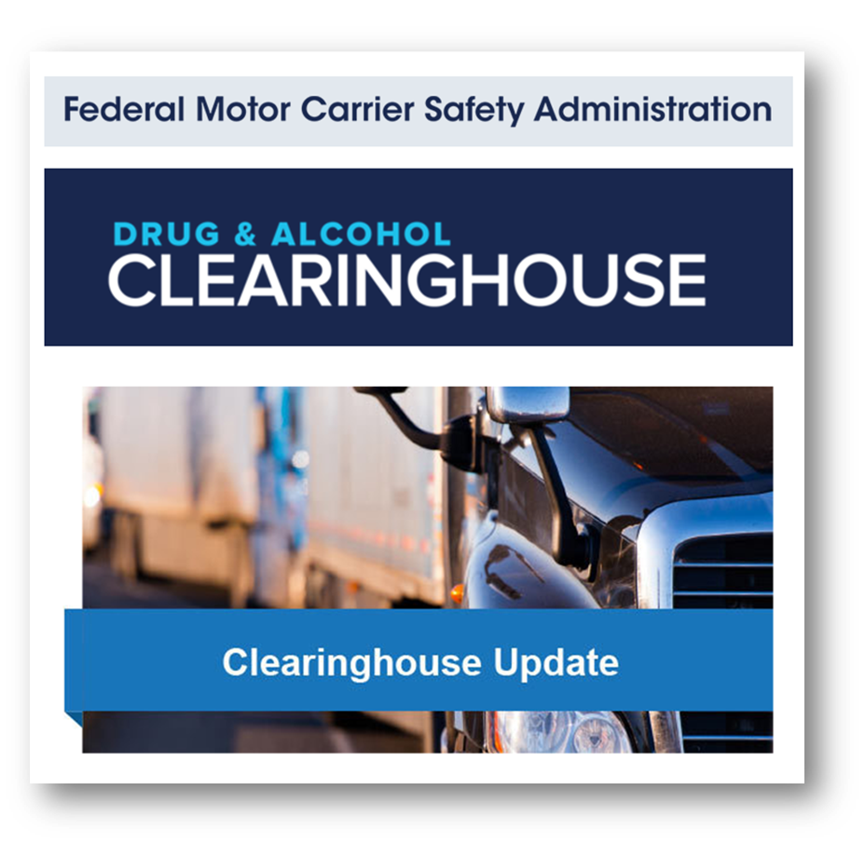
FMCSA Clearinghouse - How did we get here ?
.

Slide 5
FMCSA Clearinghouse - How did we get here ?
1991 – DOT Drug & Alcohol testing started.
Lots of violations each year removed drivers from duties.
Gap in tracking violations across employers.
Clearinghouse started January 6, 2020.
Clearinghouse did NOT change any violations.
Over 250,000 violations have been reported since then.
DACH – Drug & Alcohol ClearingHouse
SDLA – State Driver License Agency
.

Slide 6
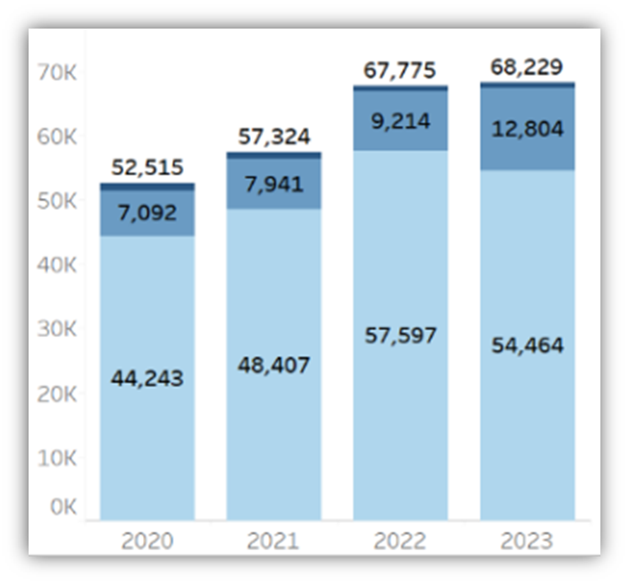
How many violations ?
251,438 as of Dec 31.
Most violations are drug positives.
Drug refusals and Actual knowledge also shown here.
Refusals jumped from 16% to 23% of violations in 2023.
.

Slide 7
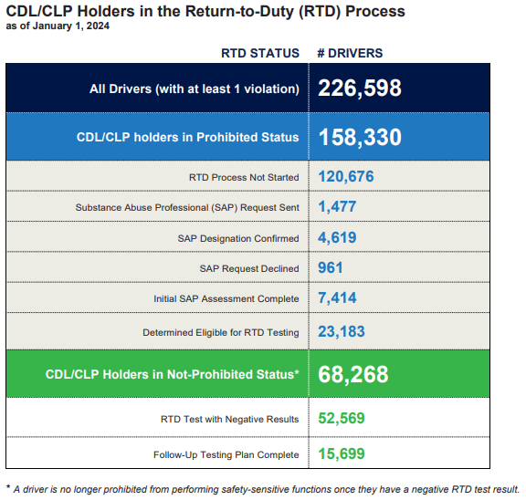
Clearinghouse Report
Through Jan 1
*Some drivers >1 violation
70% of drivers still prohibited.
10% have completed SAP but are still prohibited.
Only 7% drivers have completed the process.
.

Slide 8
Why do we need a Clearinghouse II
The first Clearinghouse rule did not give SDLAs the authority to remove commercial driving privileges, aka “downgrades”.
THP notes that inspections are finding active drivers with DACH violations is around 0.5% (overall driver positivity ~2%).
Clearinghouse II, effective November 18, 2021 with a compliance date of November 18, 2024 addressed this gap.
SDLAs must downgrade CDLs that have a “prohibited” status in the Clearinghouse.
SDLAs can start before the mandatory guidelines.
.

Slide 9
Clearinghouse Status and CDL Downgrades
As established in the first Clearinghouse final rule, drivers with a “prohibited” Clearinghouse status are prohibited from operating a commercial motor vehicle (CMV) on public roads. The second Clearinghouse final rule (Clearinghouse-II) further supports this by ensuring that drivers with a “prohibited” Clearinghouse status do not continue to hold a commercial driver’s license (CDL) or commercial learner’s permit (CLP).
Beginning November 18, 2024, State Driver Licensing Agencies (SDLAs) will be required to remove the commercial driving privileges from the driver's license of an individual subject to the CMV driving prohibition. This would result in a downgrade of the license until the driver completes the return-to-duty (RTD) process. Note: SDLAs with legislative authority currently have the option to voluntarily query the Clearinghouse and downgrade CDLs for prohibited drivers and may do so before the November 18, 2024 compliance date.
.

Slide 10
ALEA-DACH downgrades
Started downgrade process of CDL/CLP holders in February 2023.
Currently, approximately 3076 CDL/CLP holders have been downgraded.
Data from DACH is downloaded weekly (approximately 15-30 drivers).
Only 574 have completed the SAP/RTD program and reinstated.
Currently, the downgrade process is manual but will be automated before the mandatory deadline.
.

Slide 11
ALEA-DACH downgrades
Since downloading the Clearinghouse information, ALEA has been able to help identify issues and provide feedback to FMCSA regarding data.
Issues that are currently being addressed:
Drivers having 2 records in DACH:
Some examples are name spelled different, driver license number different, or date of birth different.
JOHN SMITH - John Smith (same dob/same CDL number)
Driver prohibited but test was conducted before CLP was obtained
Prohibited in DACH 11/1/22 Issued CLP:11/12/2022
License numbers not matching an AL Driver:
AL5282207 5282207777 A47300055588
Deceased Drivers
.

Slide 12
ALEA – Downgrading of Prohibited Drivers: Getting Started Early
Highway Safety - Prohibited Drivers should not be driving.
Motor Carrier Safety Unit were identifying prohibited drivers as they initiated stops and inspections. FMCSA auditors were identifying prohibited drivers during company audits.
Current guidelines require ALL Prohibited Drivers must be downgraded 60 days following compliance date of November 18, 2024.
By implementing ahead of compliance date, we were able to answer phone calls and provide prohibited drivers with the RTD process.
.

Slide 13
From an overall SDLA perspective
Thousands or tens of thousands of downgrades may cause an administrative burden on each of the 50 SDLAs.
In Tennessee, there are 3,800 “Prohibited” drivers out of 155,000 total drivers. That is 2.5% prohibited drivers still on the road.
Each SDLA will choose their system and framework for the downgrade, which may increase complication.
Incorrectly posted violations may create an issue to correct within the system – first remove DACH violation then reinstate license.
Other SDLA functions may be affected for late adopter states due to this burden.
.

Slide 14
From a Carrier perspective
If a carrier has been correctly performing Clearinghouse queries, Clearinghouse II SHOULD not cause significant disruption.
Particularly since the Clearinghouse now notifies a carrier within 12 months of a query if the driver status changes.
Affected drivers should not be not YOUR drivers.
There will be some issues with incorrect violations and reinstatement of CDL status.
How hard is it for a “Prohibited” driver to get back to work ?
How many carriers have an RTD program ?
.

Slide 15
From a Driver perspective
DOT regulations were designed to have “a path forward” for drivers with a violation.
In reality, many carriers are hesitant to hire RTD drivers due to increased liability, increased positivity, and increased job-jumpers.
Clearinghouse II will make this significantly more difficult for carriers and drivers.
A negative RTD test is required to remove “Prohibited” status.
Will a carrier put a “Prohibited” driver through Orientation, let them take an RTD test, then wait for the driver to have their CDL reinstated?
Carriers must also be leery of job-jumpers.
.

Slide 16
Clearinghouse Report
15% of Prohibited drivers are eligible for RTD testing.
SAP process completed but cannot find an employer to Return them to Duty.
23% of drivers with a violation are “Not Prohibited” but have not completed their Follow Up testing program.
Some of these are drivers working out their Follow Up plan, but some are drivers that have not disclosed their RTD status to their carriers.
.

Slide 17
Six Steps of the RTD process
.

Slide 18
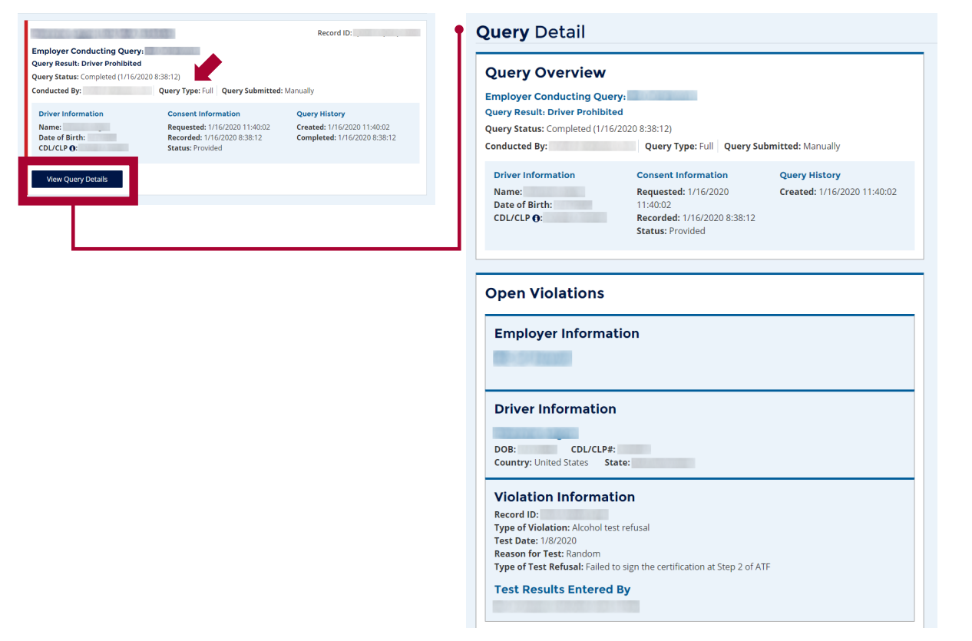
The Devils are in the “Details”
A Pre-employment query may show “Not Prohibited”.
Always click the “Details” button.
This will tell you if the driver has an open Violation.
Look for multiple violations, date of RTD testing, both Drug and Alcohol violations.
Disreputable SAPs – minimal testing for serious offenders. SAP plans not meeting minimum requirements
Disreputable Carriers – marking Follow Up plans complete prematurely.
.

Slide 19
Points to remember about RTD drivers:
Check with your insurance for any restrictions on hiring RTD drivers
Employers are not required to perform a RTD test after a driver completes an SAP program if they don’t want to bring the driver back
Only an employer can order a RTD test. It must be directly observed and does take the place of a Pre-employment test
.

Slide 20
Rhonda Harris
ALEA
334-676-7319
rhonda.harris@alea.gov
Grady Phillips
WorkforceQA
931-261-9579
gphillips@wfqa.com
.

Slide 21
Actual Knowledge?
Actual knowledge …means actual knowledge by an employer that a driver has used alcohol or controlled substances based on the employer's direct observation of the employee, information provided by the driver's previous employer(s), a traffic citation for driving a CMV while under the influence of alcohol or controlled substances or an employee's admission of alcohol or controlled substance use, except as provided in § 382.121. Direct observation as used in this definition means observation of alcohol or controlled substances use and does not include observation of employee behavior or physical characteristics sufficient to warrant reasonable suspicion testing under § 382.307. As used in this section, “traffic citation” means a ticket, complaint, or other document charging driving a CMV while under the influence of alcohol or controlled substances.
.

