Slide 2
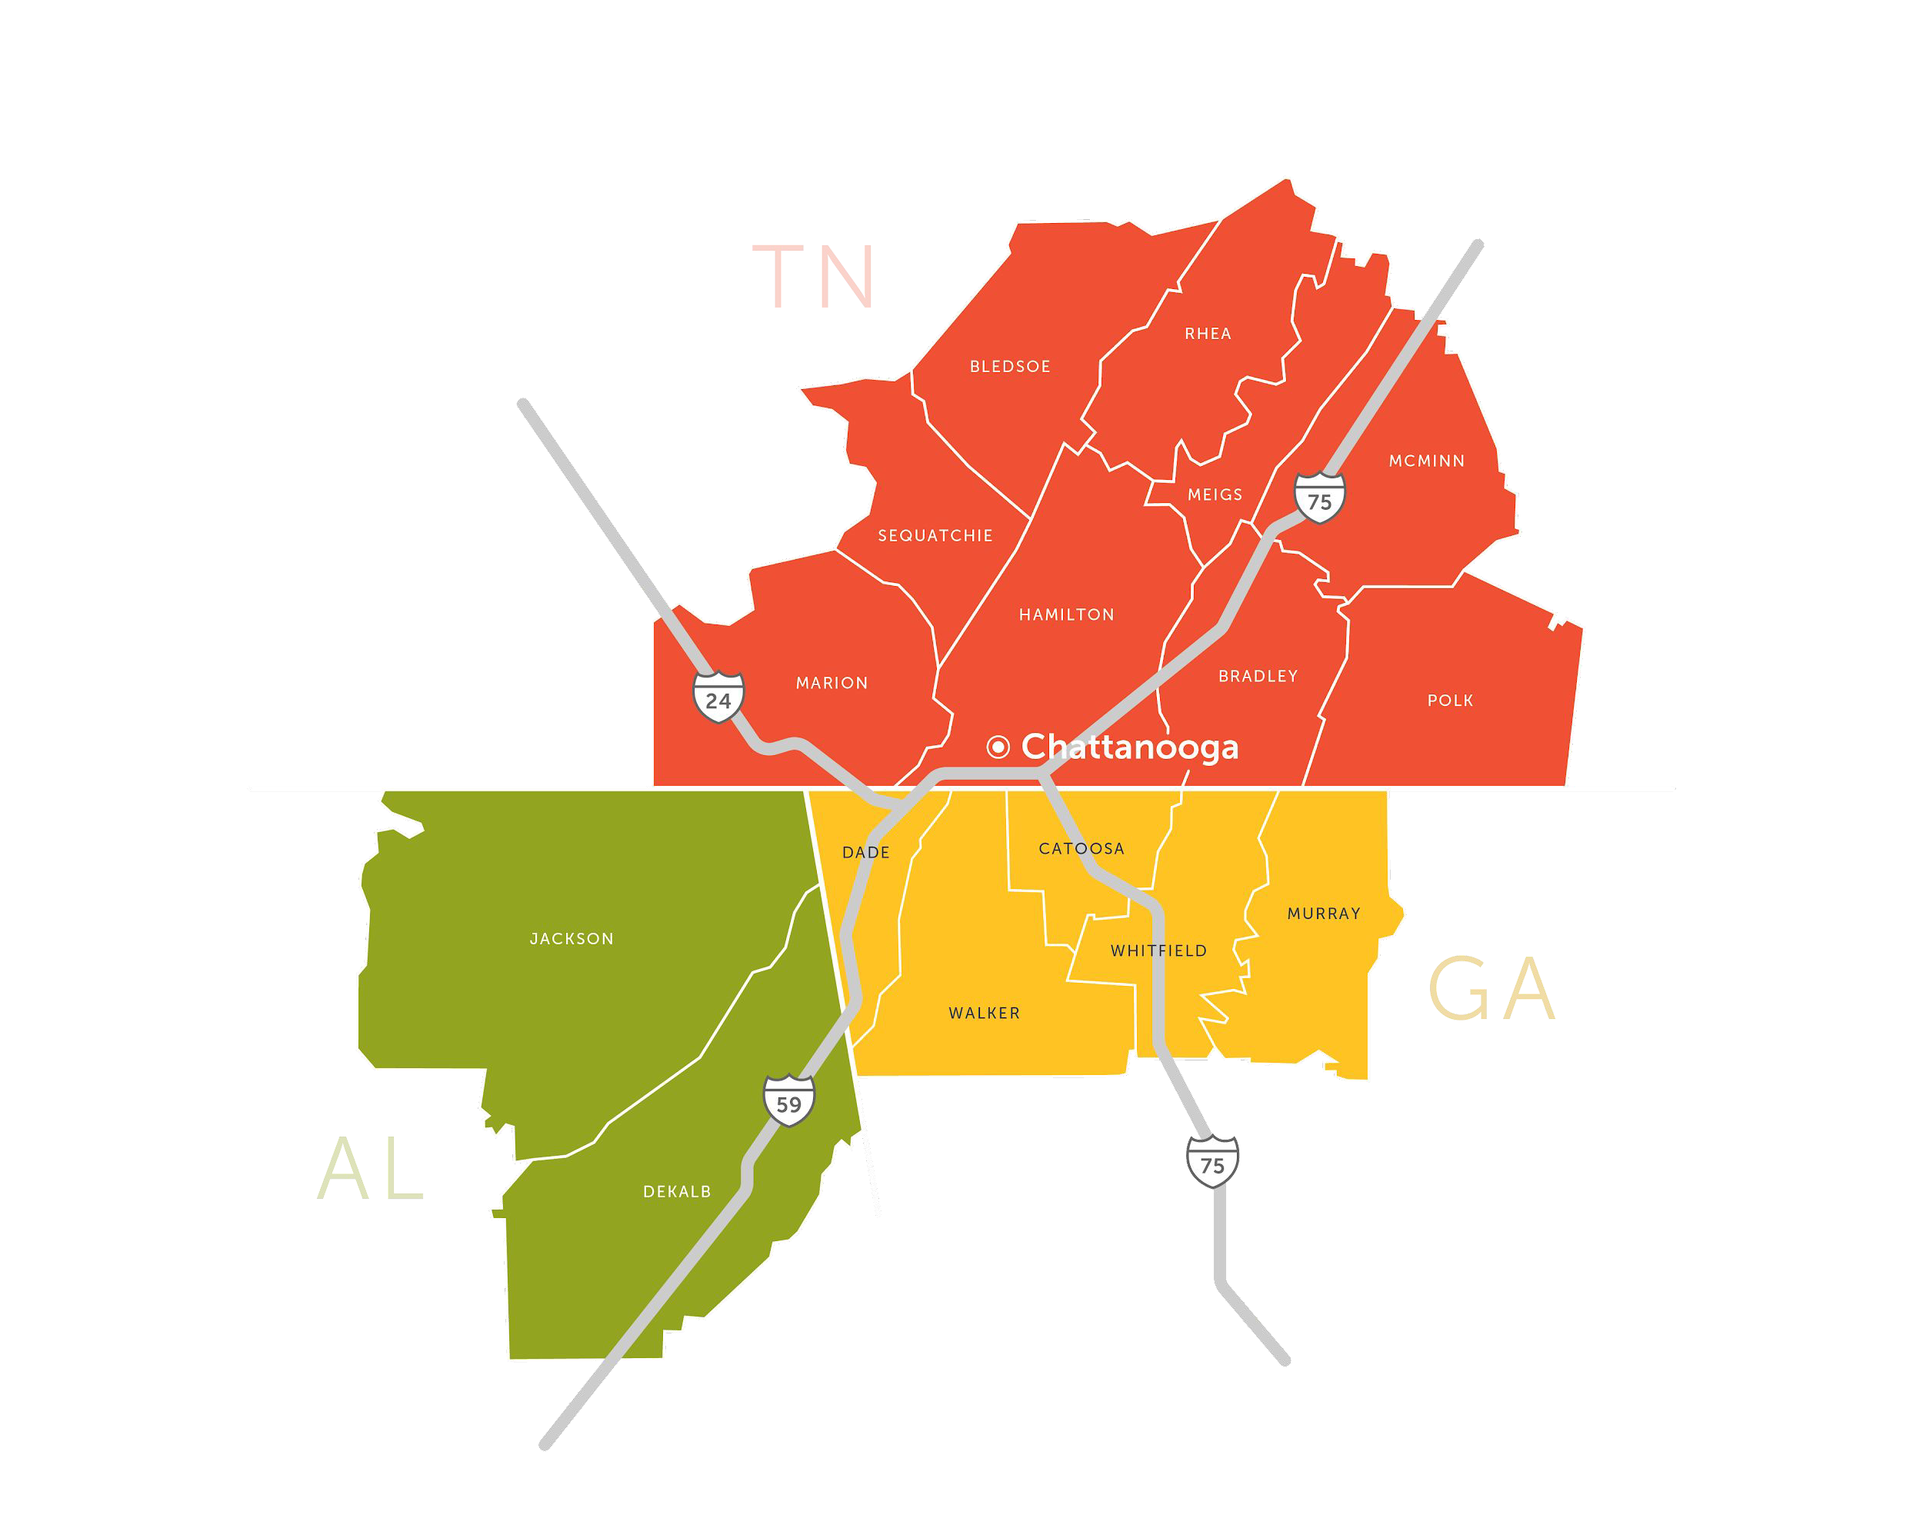
Mission
Thrive Regional Partnership inspires responsible growth through conversation, connection, and collaboration in the tri-state Chattanooga region.
We convene stakeholders across the region to ensure that as we grow in industry, prosperity, and population, we also preserve community and natural character for generations to come.
Our footprint includes 16 counties across northeast Alabama, northwest Georgia, and southeast Tennessee.

Slide 3
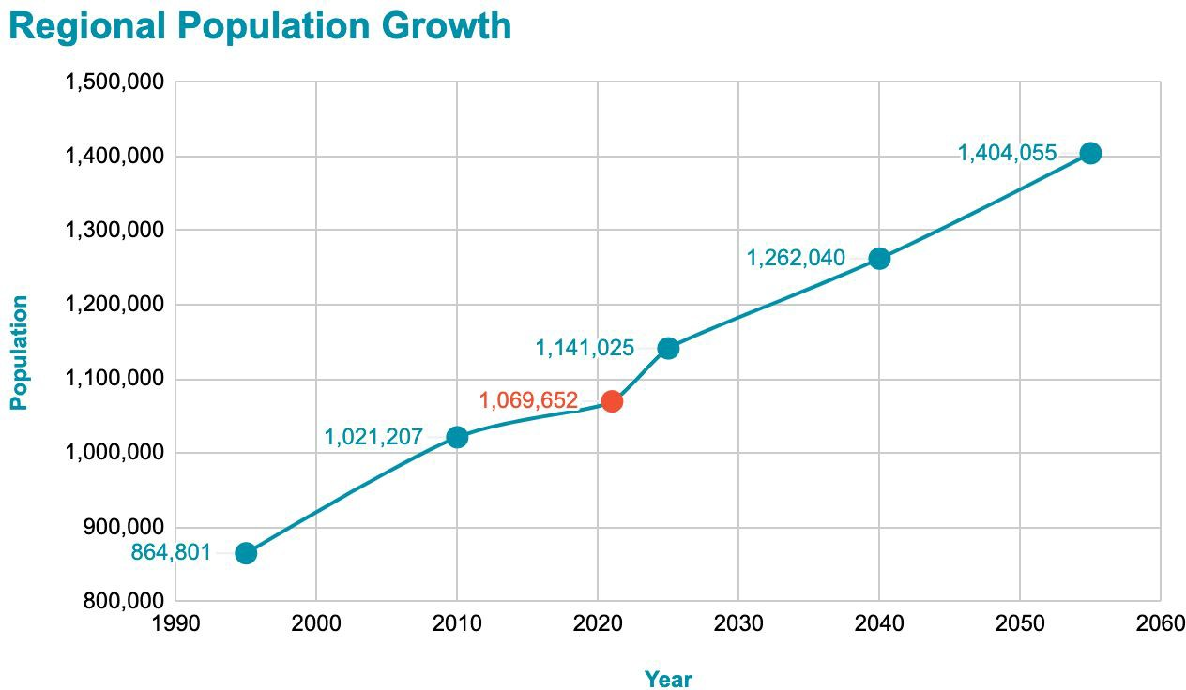
…to ensure that as we grow in industry, prosperity, and population,

Slide 4
…we also preserve community and natural character for generations to come.
Chattanooga overlooking Moccasin Bend and the Tennessee River, The Dyrt
Star Mountain, Photo: Victoria Stamey

Slide 5
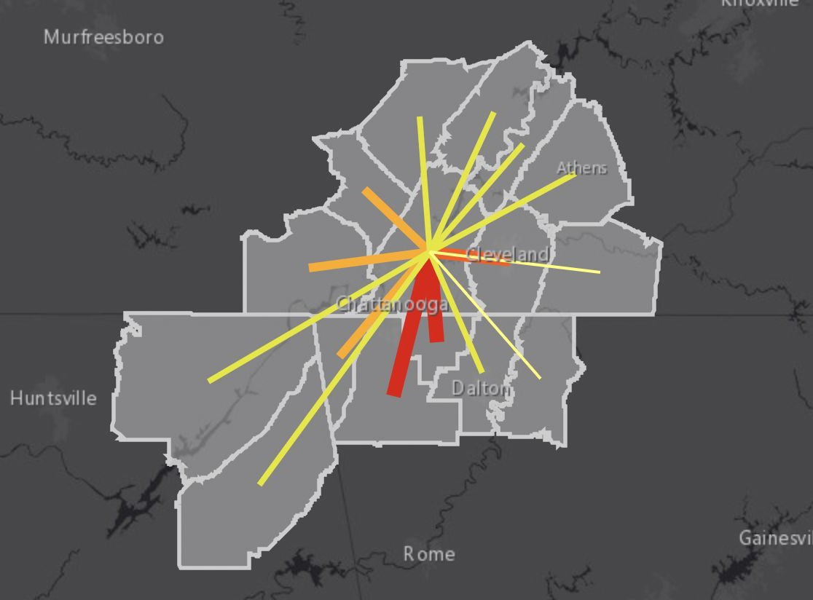
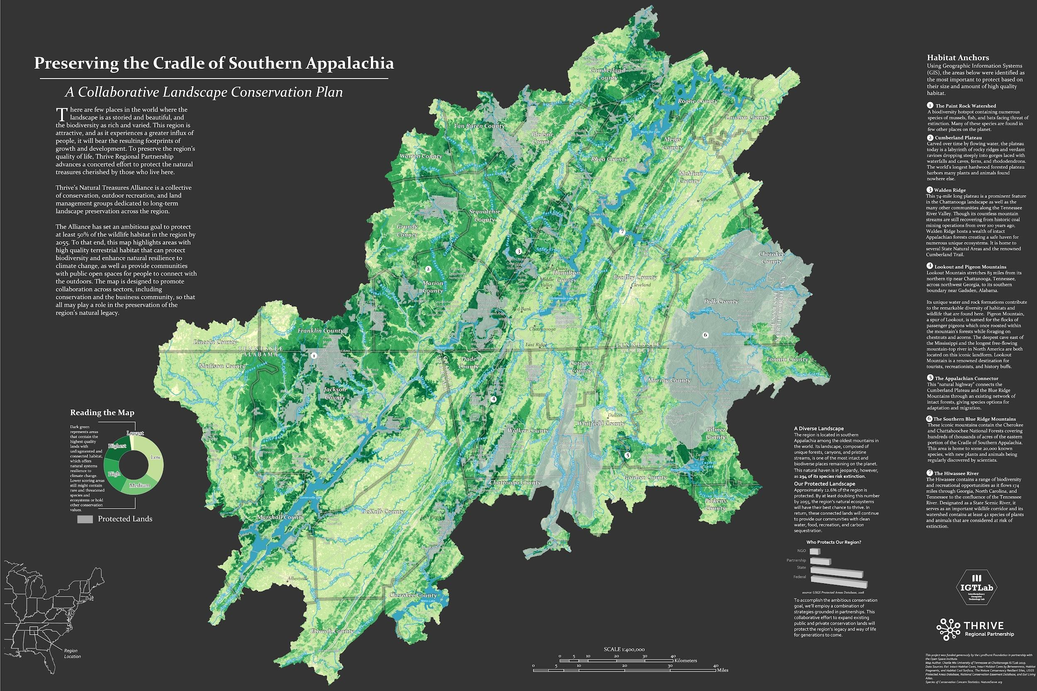
Why think regionally?

Slide 6
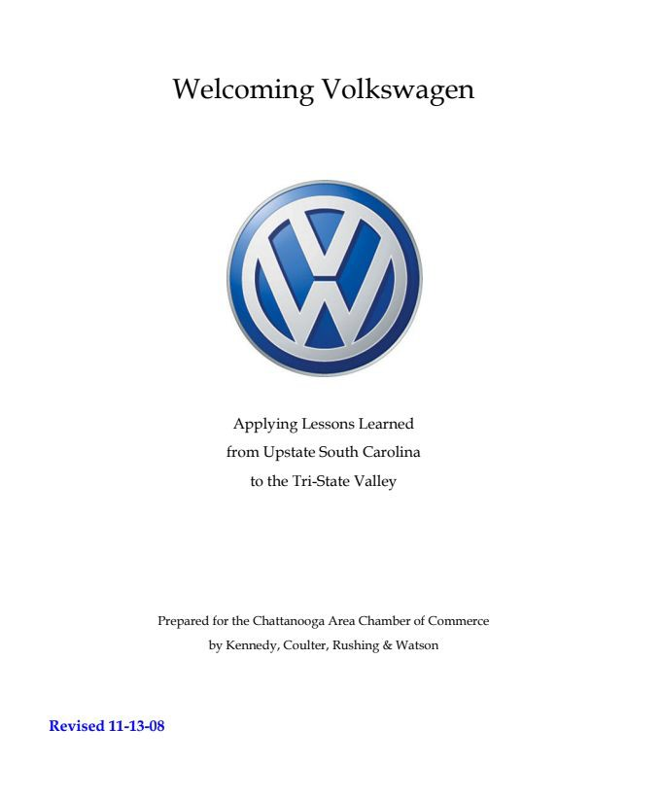
How Thrive Started

Slide 7
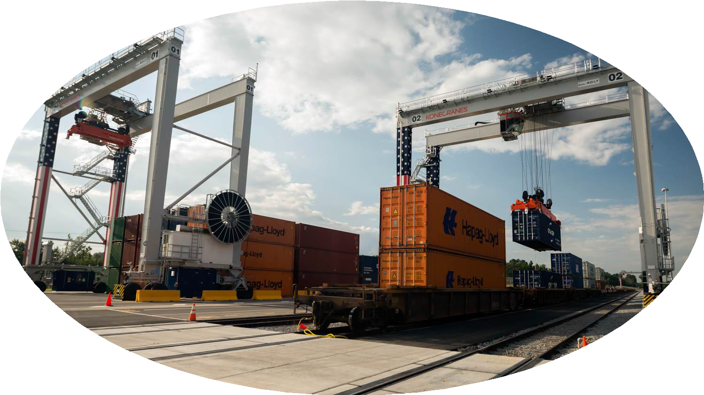
Impact Areas
Transportation + Infrastructure
Natural Treasures
Community Prosperity

Slide 8
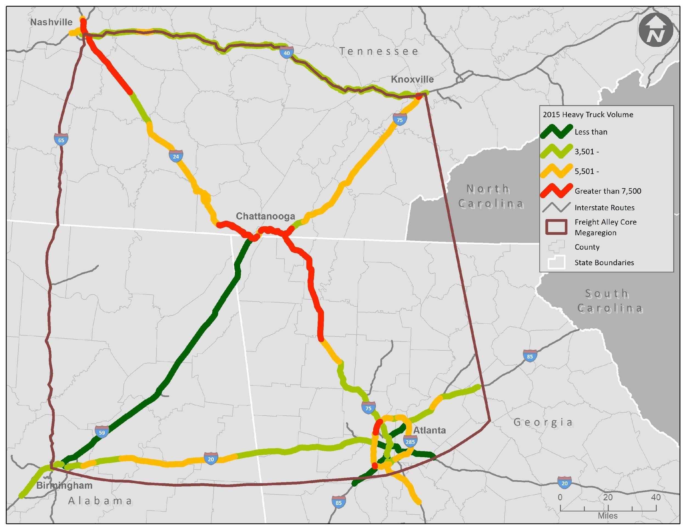
2015 Heavy Truck Volume Corridors 7,500+ trucks per day
Source: GDOT Travel Demand Model, TDOT Travel Demand Model, Count Data from ALDOT, GDOT, TDOT, CDM Smith analysis, 2020
Thrive Regional Partnership
Inspiring Responsible Growth ⁹

Slide 9
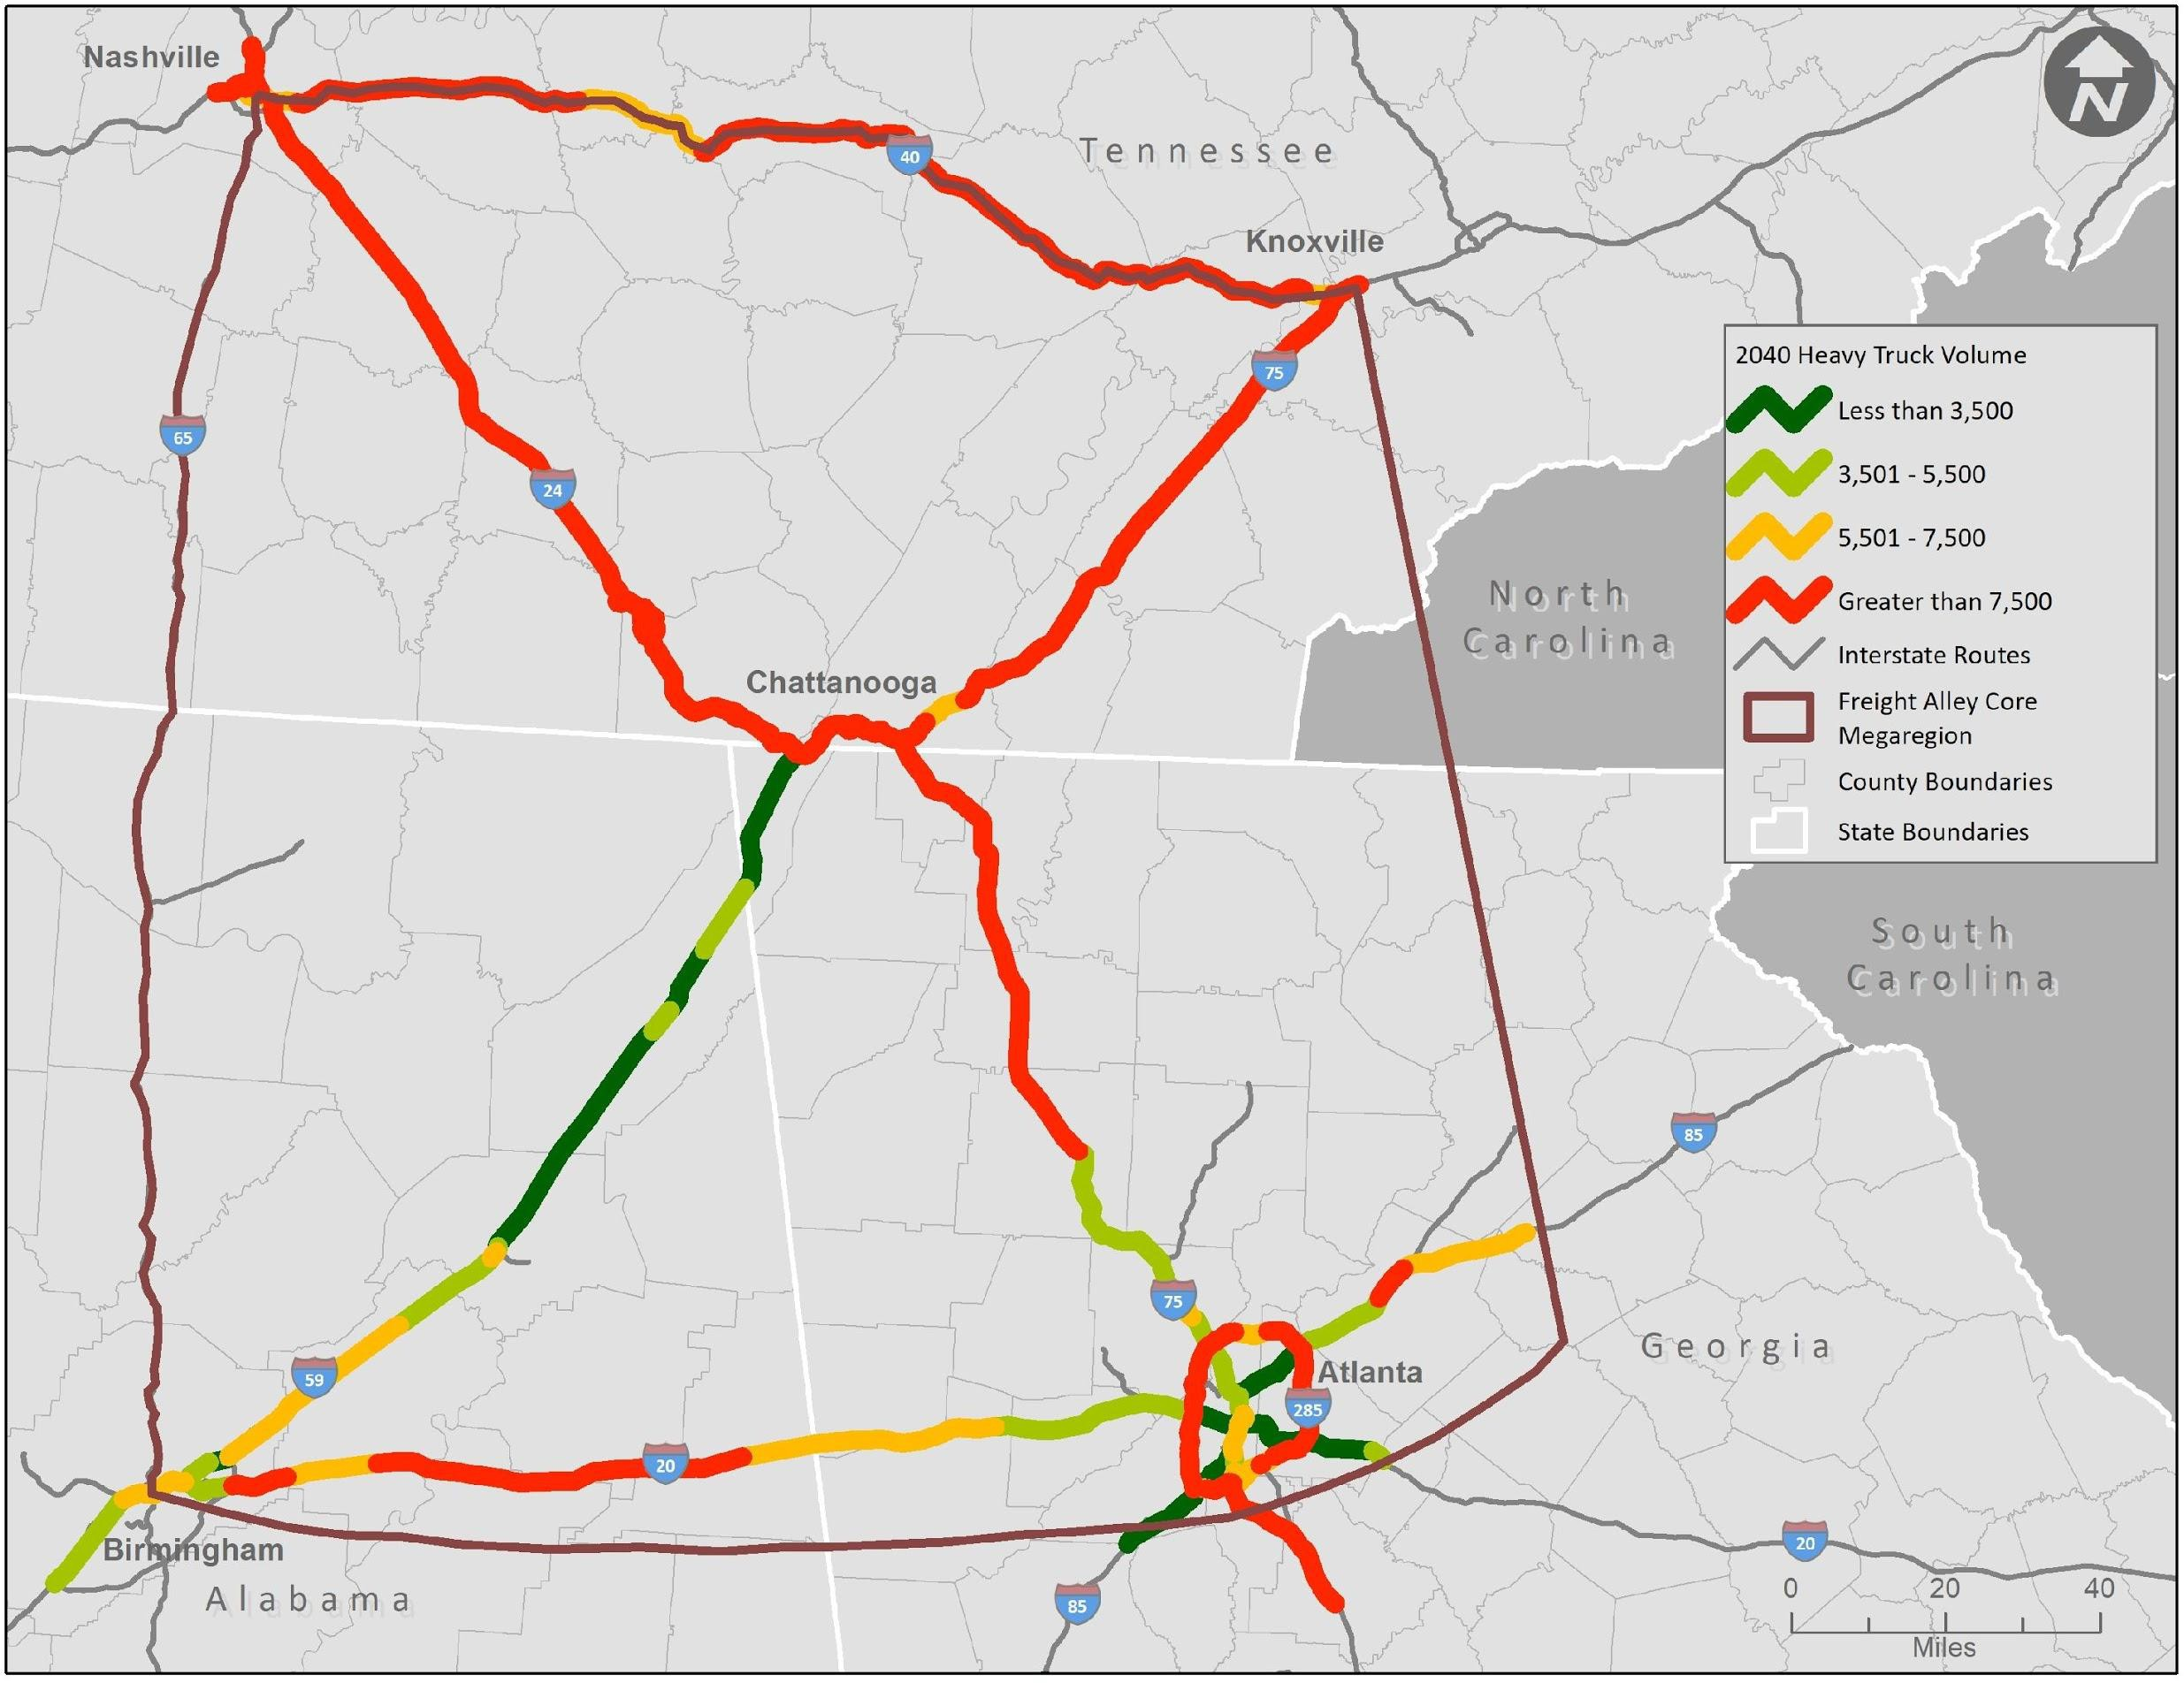
2040 Heavy Truck Volume Corridors 7,500+ trucks per day
10
Source: GDOT Travel Demand Model, TDOT Travel Demand Model, Count Data from ALDOT, GDOT, TDOT, CDM Smith analysis, 2020

Slide 10
Moving Freight Alley Forward
5.9 million
Shipping container units passed through the Port of Savannah in 2022, setting new record cargo volumes
80%
Freight through traffic, meaning it originates outside of the region without destination within the region
39 million
Tons of freight per year is projected to flow through the Chattanooga urban area alone by 2035

Slide 11
Core Team Partners

Slide 12
Aspirations of the TRIP Platform
Provide a baseline of modes, moves, and facilities across the region.
Increase awareness and academic institution focus on multimodal freight movement.
Support regional planning and projects by validating trends and the importance of tri-state linkages for economic development and efficiencies.
Provide maps, data, and analysis approaches that can be adopted by states in support of their efforts.
Promote a multimodal approach to understanding and defining freight corridors.
Promote a greater understanding of freight policy and program options, and the operational and real-world consequences for freight systems and the economy.

Slide 13
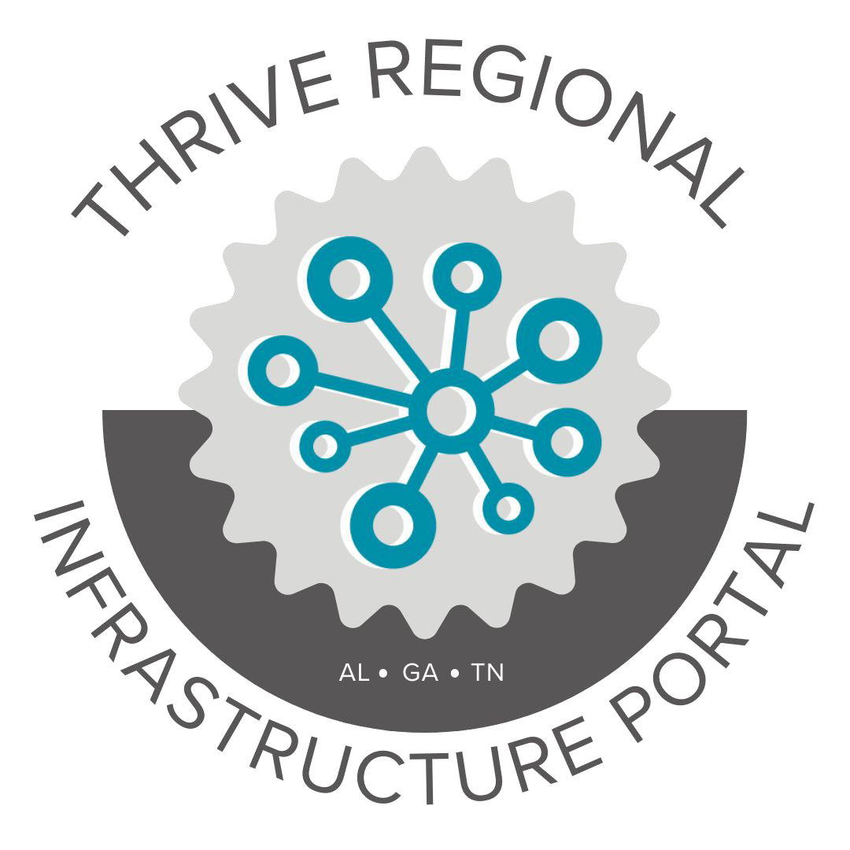
The TRIP Platform
Geospatial gateway to transportation and freight data, maps, and resources for greater Chattanooga
Find data
View and interact with maps
Learn about freight movement in the region

Slide 14
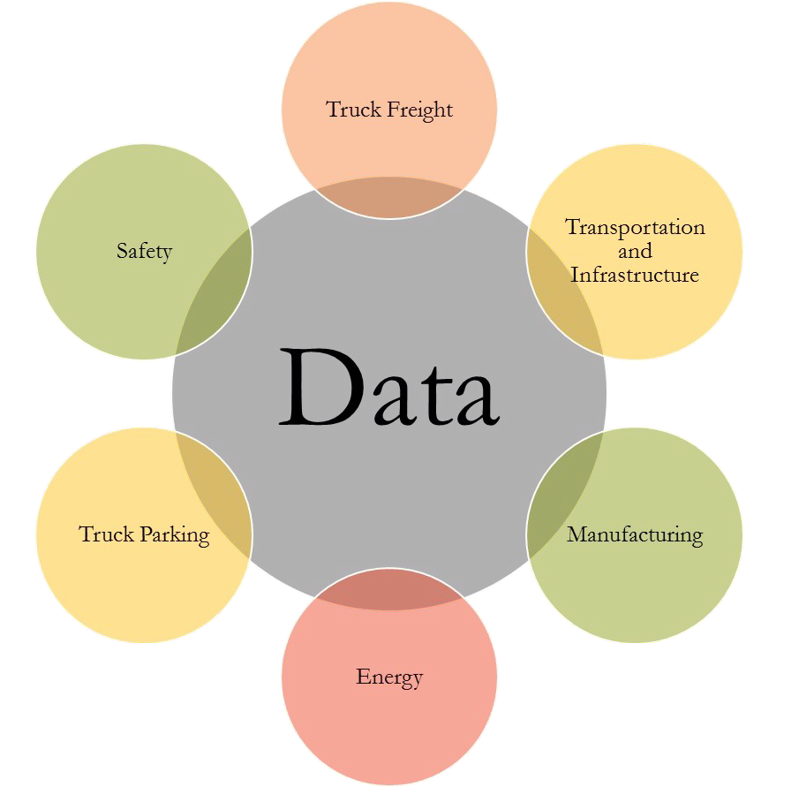
Explore and Access Data
View, download or stream nearly 50 datasets compiled from national, state, and local level data providers
Complete list of data sources
Metadata
Attribute descriptions

Slide 15
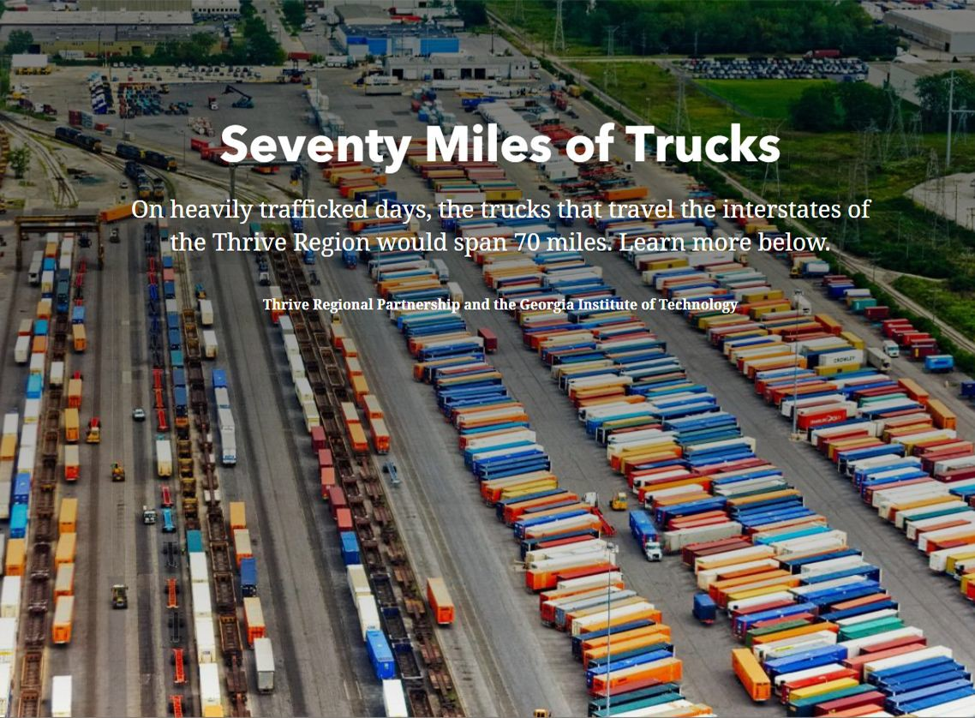
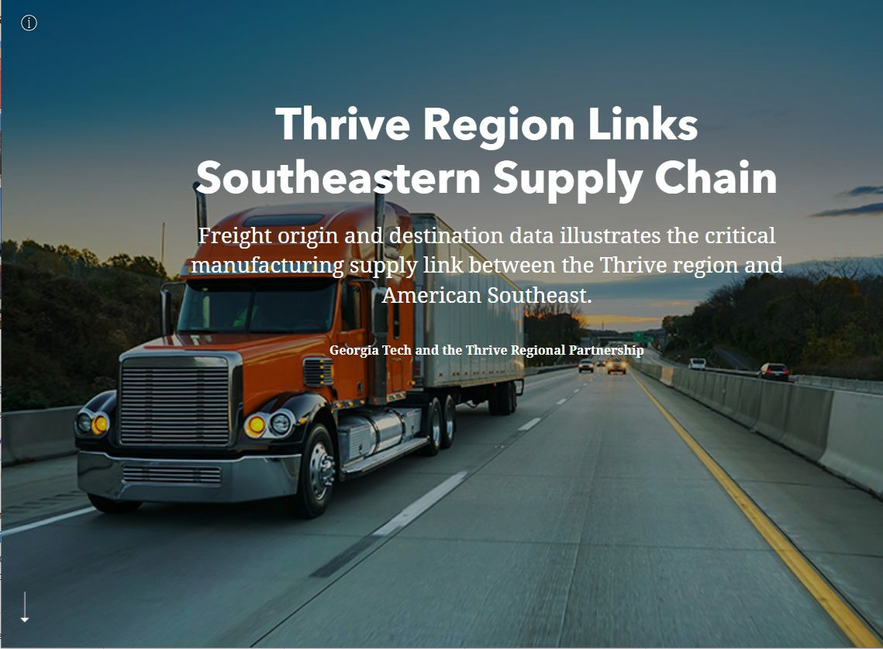
StoryMaps
Check out the StoryMaps to learn more about truck freight value, weight, and frequency of truck shipments to and from the region
Commodity Flow Estimates 2022
Freight Analysis Framework Network Flow Estimates
TRIP Tutorials

Slide 16
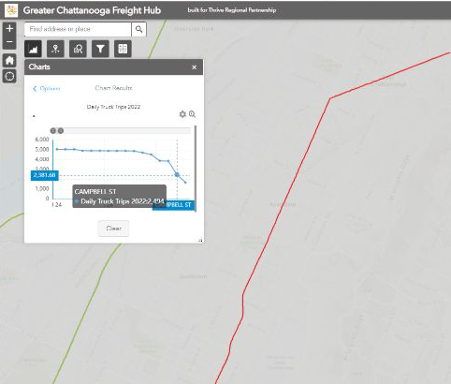
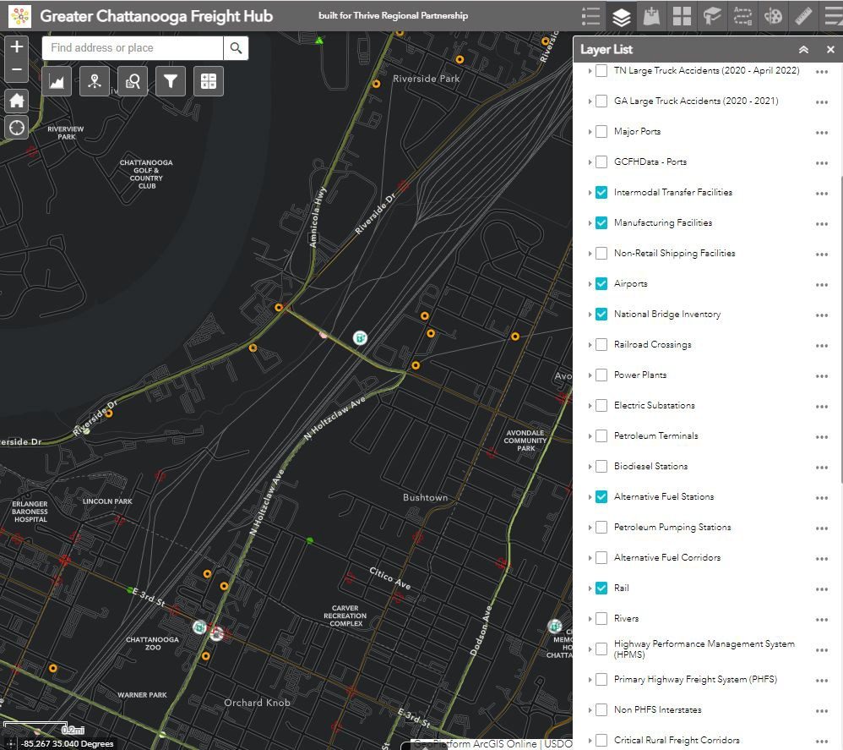
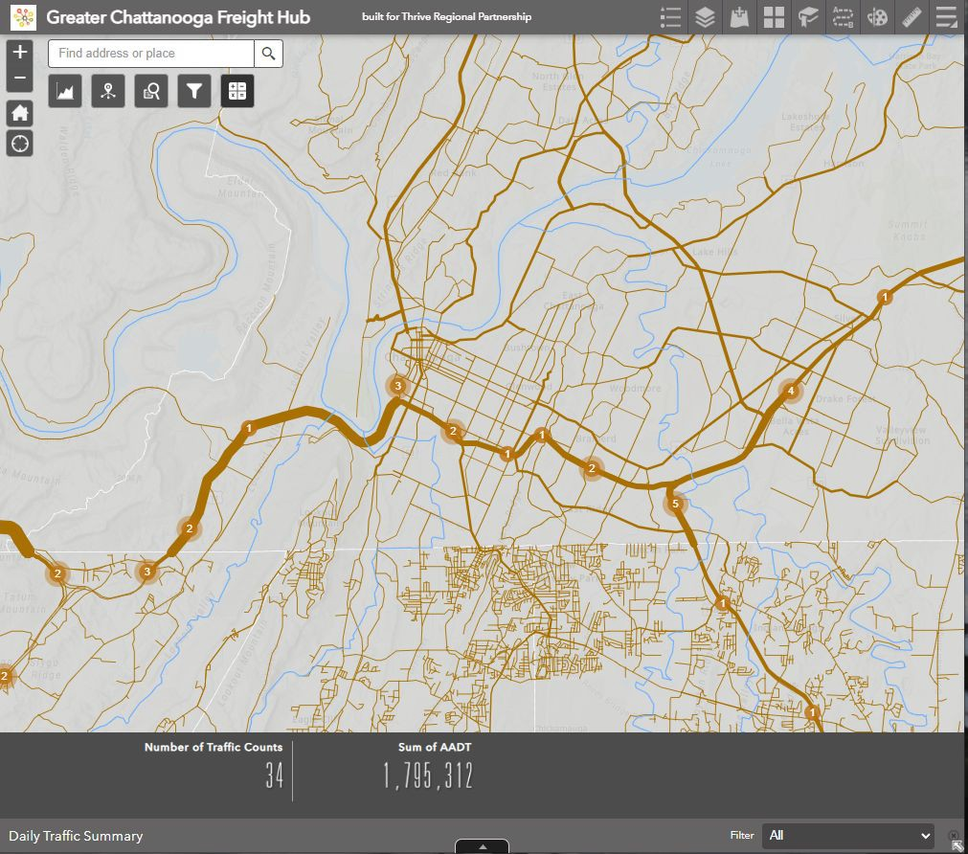
Interactive Map
Explore the data on your own through the TRIP Interactive Map
Charts and Queries
Filters and Summaries
Print
Draw and Measure
Change basemaps
Zoom in and out and turn layers on and off
Add your own data or connect to AGOL

Slide 17
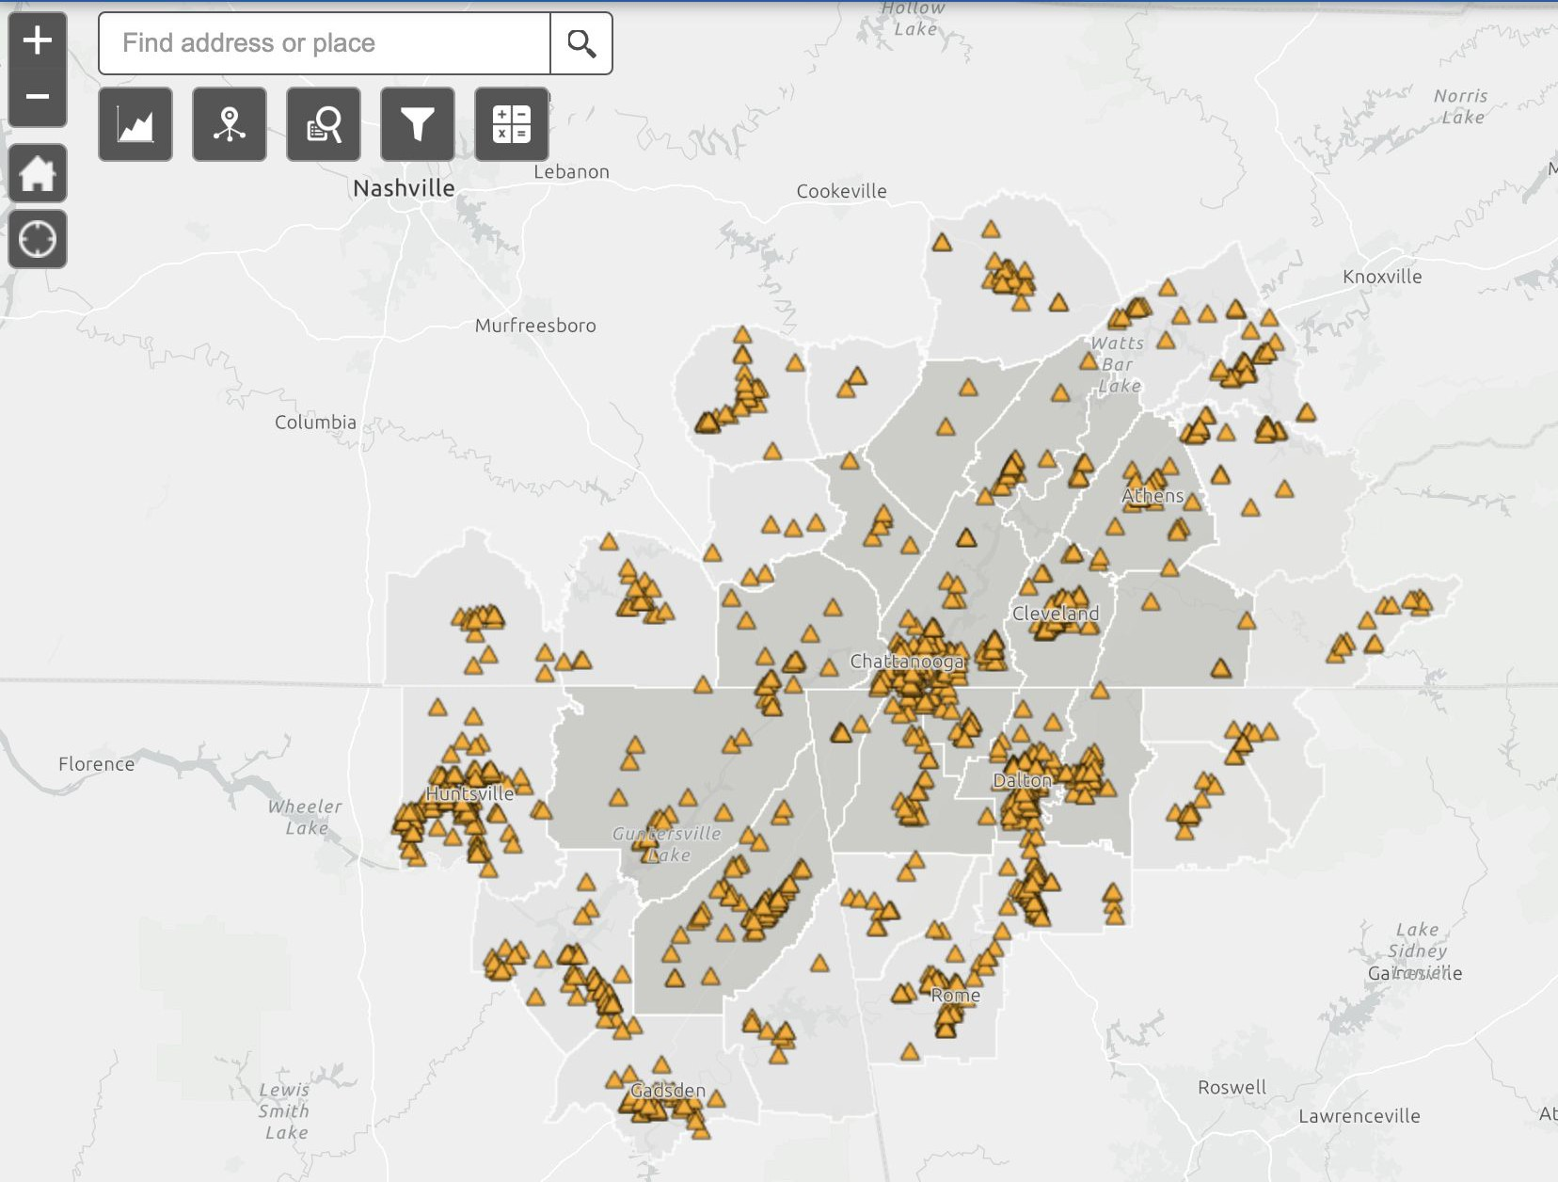
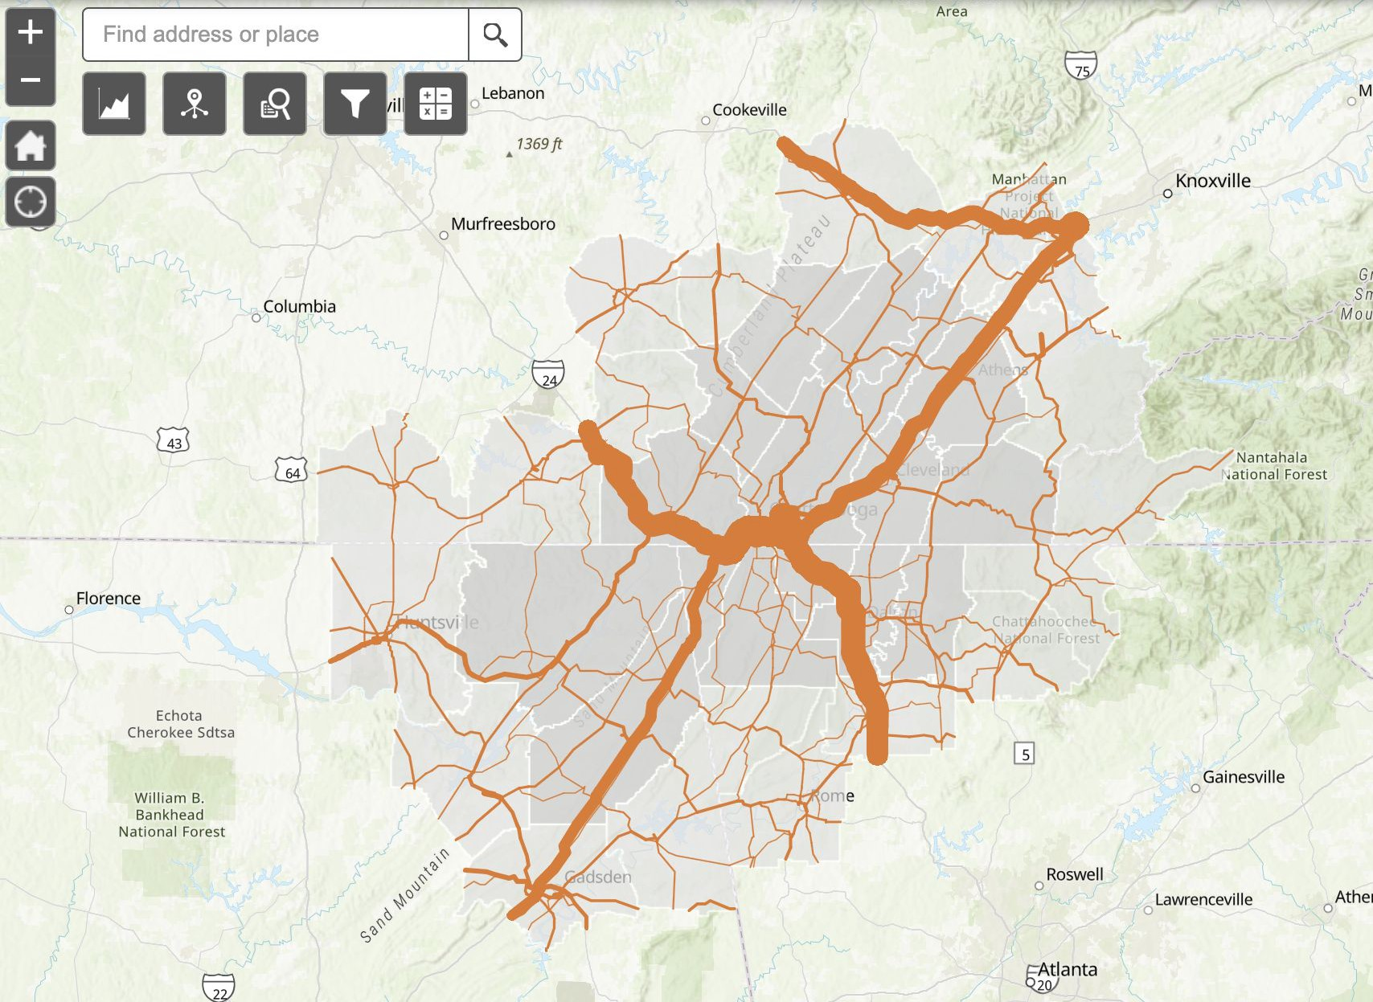
Freight Generators

Slide 18
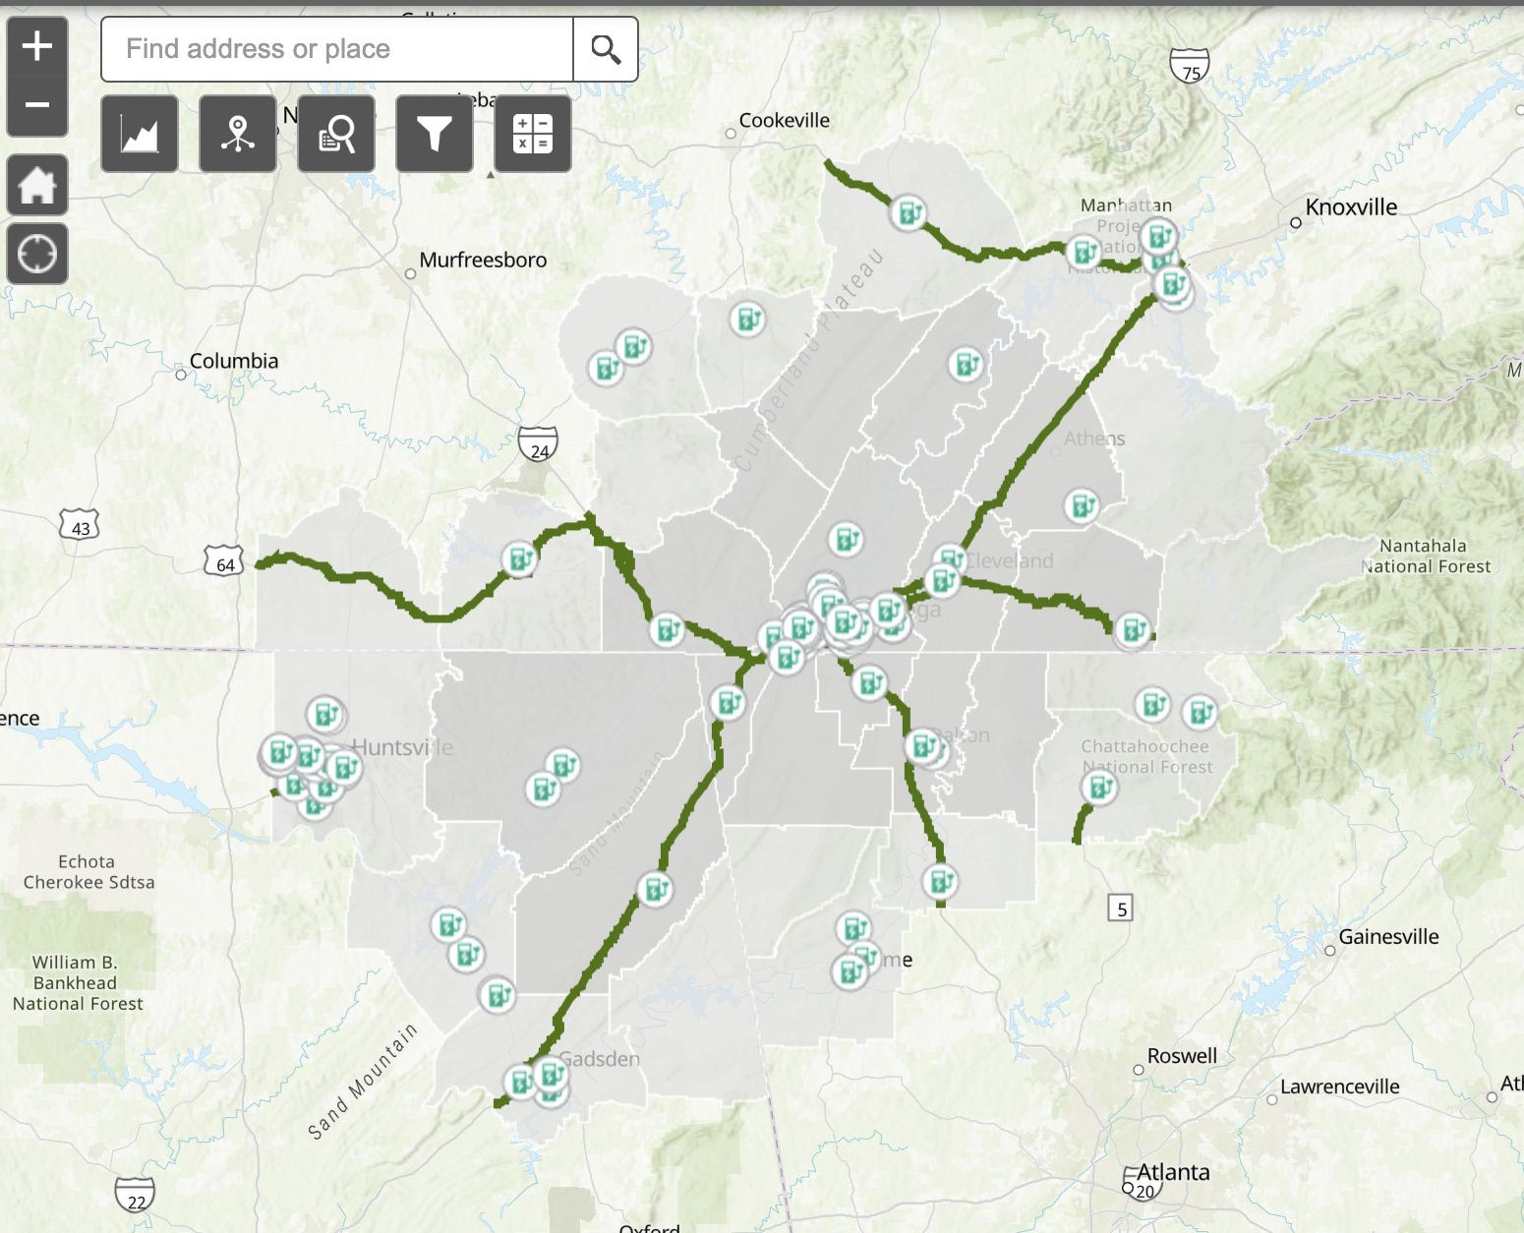
Electric Vehicle Infrastructure
Primary consumer concerns are range of EVs and a reliable charging infrastructure
164 public & private electric vehicle charging stations
Street address, access hours, type of charger, pricing

Slide 19
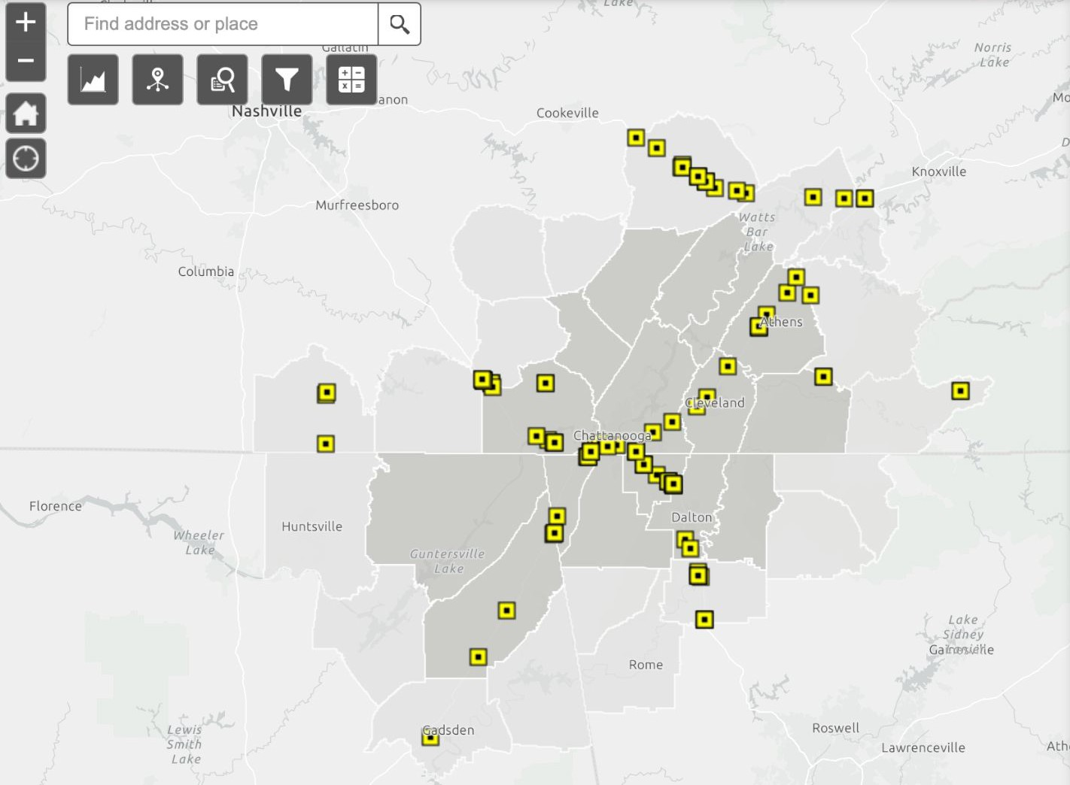
Truck Parking Availability
Drivers cite congestion & truck parking as biggest issues
64 public & private truck parking facilities
Location, phone number, parking spaces, diesel lanes, internet access, shower facilities, laundry

Slide 20
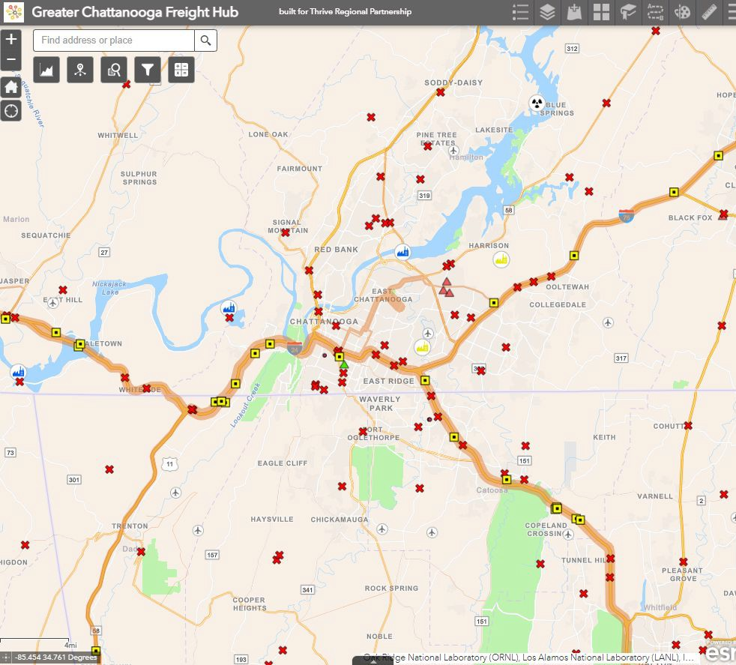
What’s Next?
Collaborative freight mobility benchmarks
Data updates
Identify focus themes
Build additional GIS tools
Assist communities in identifying projects of significance

Slide 21
The Thrive Regional Infrastructure
Portal
“Thrive has taken data and not only made it available to planners like myself, but they've made this data available to business owners, school systems, to where even if you're not in the ﬁeld, you can still go on there and use the tool” and “see ﬁrsthand how it beneﬁts you from multiple diﬀerent aspects.” -Jacob Bearden, Planning and Zoning Coordinator with the Greater Dalton MPO
By collaborating with Georgia Tech and Cleveland State, our groundbreaking data reporting will oﬀer users the opportunity to discover, interpret, and improve elements related to freight mobility across our region and beyond.
Through ARC’s investment in Thrive’s organizational structure and needs, our Transportation and Infrastructure programming will be able to provide quality information to decision makers, planning organizations, and even private companies that can help increase freight eﬃciency.

Slide 22
Partnership with Cleveland State Community College
Cleveland State Logistics & Supply Chain Management Program
Program launched Fall 2022
Accelerated, cohort format with in-person or online options
Courses created using funds provided from Thrive’s Program
Capstone Course & TRIP Portal
Capstone course launches Spring of 2024
TRIP portal will be integrated into course for student projects
ICON or PHOTO
“A terrific curriculum - I think this is the best blending I have ever seen, for what industry needs
- analytics/math background/core skills/experiential/ SC domains, etc.”
- Georgia Tech Professor of Practice in Supply Chain Management

Slide 23
Thank you!
Learn more at thriveregion.org

