Slide 1
Crash Prevention & Reduction
Chattanooga Area
2024 Safety Coalition Meeting
Dollena McHenry, Ph.D. | February 22, 2024

Slide 2
CY 2022 TN Truck Shipments
$530.96 billion – freight value
354.6 million tons – freight by weight
Notes:
Picture Source: https://workzonesafety.org/topics-of-interest/large-truck-safety/ (accessed 10/27/2023)
Data Source: https://tripnet.org/wp-content/uploads/2023/11/TRIP_Freight_Report-Appendix_2023.pdf (accessed 02/20/2024)
TRIP: A National Transportation Research Nonprofit December 2023 report, America’s Rolling Warehouses

Slide 3
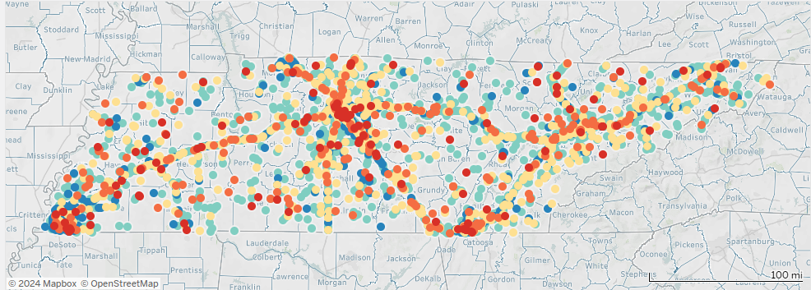
CY 2023 FMCSA Reportable Large Truck Crashes
12,851
Notes:
Tennessee Department of Safety & Homeland Security, TITAN Division, 02/16/2024 (TITAN database).
CY 2023 – Tennessee Crash Data
- 12,851 reported Large Truck crashes in TN

Slide 4
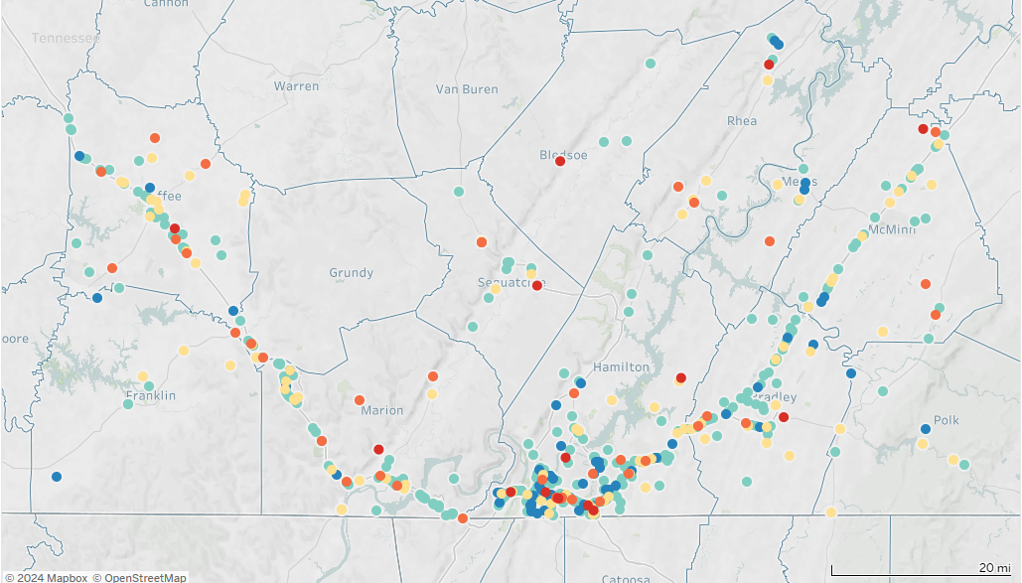
THP District 2
1,543
Notes:
Tennessee Department of Safety & Homeland Security, TITAN Division, 02/16/2024 (TITAN database).
THP District 2 includes Bledsoe, Bradley, Coffee, Franklin, Grundy, Hamilton, McMinn, Marion, Meigs, Polk, Rhea, & Sequatchie counties.
Map shows FMCSA reportable large truck crashes in CY 2023.
There were 8,545 crashes involving Large Trucks in District 2. 12% of all Large Truck crashes in the state.

Slide 5
Large Truck Involved Crashes
Notes:
CY 2023 TN data:
– 7.2% is roughly 1 in 14 crashes
– 8.1% is roughly 1 in 12 crashes
Tennessee Department of Safety & Homeland Security, TITAN Division, 02/16/2024 (TITAN database).
Notes:
Metro Nashville Police Department stopped responding to most property damage only crashes 4/12/2021.
Knoxville Police Department stopped responding to some non-injury crashes 09/01/2022.

Slide 6
A Crash involving a large truck occurred every 40 minutes, 58 seconds.
Notes:
Tennessee Department of Safety & Homeland Security, TITAN Division, 02/16/2024 (TITAN database).

Slide 7
An injury crash involving a large truck occurred every 3 hrs, 11 mins, 49 secs.
Notes:
Tennessee Department of Safety & Homeland Security, TITAN Division, 02/16/2024 (TITAN database).

Slide 8
One person was killed in a crash involving a large truck every 2 days, 4 hrs, 27 mins.
Notes:
Tennessee Department of Safety & Homeland Security, TITAN Division, 02/16/2024 (TITAN database).

Slide 9
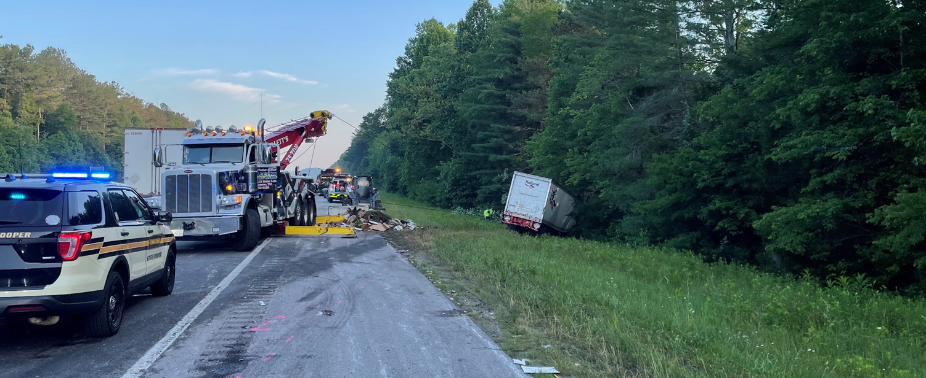
Large Truck Involved Crashes CY 2023
1 in 17 injury crashes
1 in 8 fatal crashes
District 2 – 1 in 6 fatal crashes
Notes:
Tennessee Department of Safety & Homeland Security, TITAN Division, 02/16/2024 (TITAN database).
The more serious the crash, the more likely a large truck was involved.
The five year rates (CY 2019 thru CY 2023) are the same as CY 2023 rates.
Injury crashes included possible injury, suspected minor injury, and suspected serious injury crashes.
CY 2023 - Fatal and injury crashes combined: 1 in 17
A Large Truck was involved in 1 out of 6 fatal crashes in District 2 and 1 in 16 injury.

Slide 10
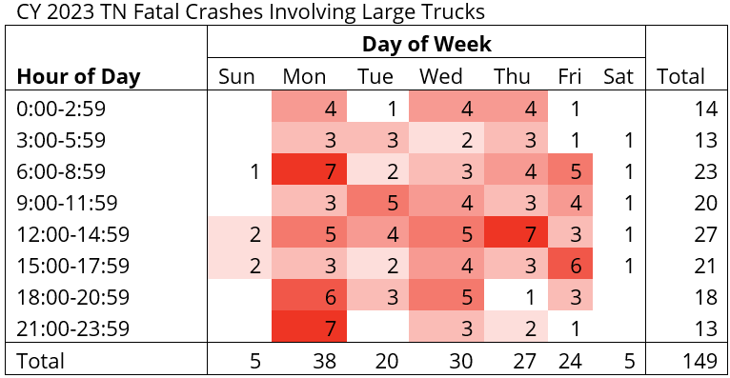
2023 TN Truck Involved Fatal Crashes
25.5%
20.1%
18.1%
Notes:
Source: Tennessee Department of Safety & Homeland Security, TITAN Unit, 01/19/2024 (TITAN-FARS database).
1 in 4 fatal crashes involving a Large Truck occurred on a Monday in CY 2023.
63.76% (6 out of 10) occurred on Monday, Wednesday, Thursday.

Slide 11
2023 Non-Motorist Fatal Truck Crashes
19 out of 149 large truck involved fatal crashes
26 fatalities
24 pedestrians
2 building occupants
3 pedestrians killed in work zone
2 fatalities/crashes due to equipment failure
Notes:
Source: Tennessee Department of Safety & Homeland Security, TITAN Unit, 01/19/2024 (TITAN-FARS database).
1 in 8 large truck involved fatal crashes involved a non-motorist. (19/149 = 12.8%)

Slide 12
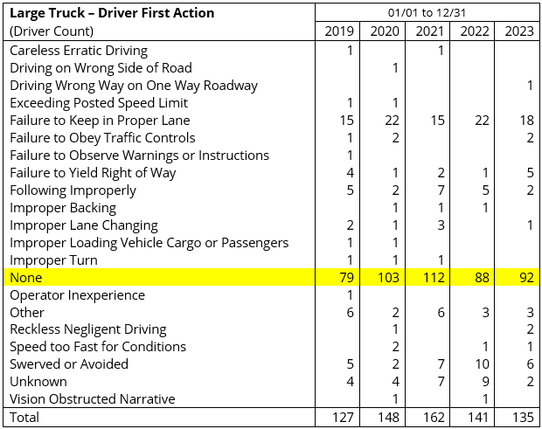
Notes:
Source: Tennessee Department of Safety & Homeland Security, TITAN Unit, 01/19/2024 (TITAN-FARS database).

Slide 13
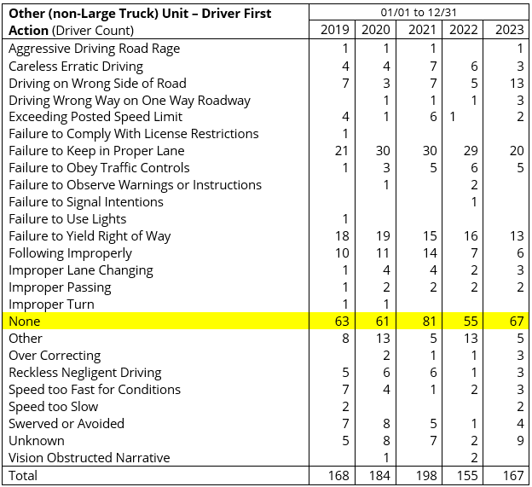
Notes:
Source: Tennessee Department of Safety & Homeland Security, TITAN Unit, 01/19/2024 (TITAN-FARS database).

Slide 14
2023 TN Truck Involved Fatal Crashes
January through December 2023 data show the initial action of 57.6% (91 out of 158) of NON-Truck drivers contributed to the fatal crash compared to 30.8% (41 out of 133) of the initial actions of the Large Truck drivers.
Notes:
Source: Tennessee Department of Safety & Homeland Security, TITAN Unit, 01/19/2024 (TITAN-FARS database).

Slide 15
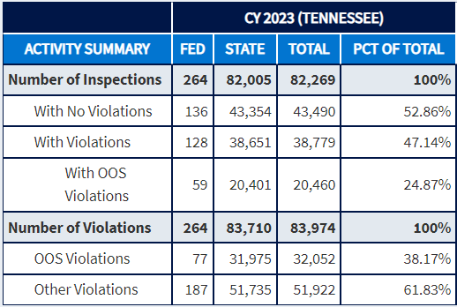
TN Roadside Inspection Activity CY 2023
1 in 4 placed OOS
Notes:
Data Source: FMCSA’s Motor Carrier Management Information System (MCMIS) data snapshot as of 1/26/2024, including current year-to-date information for CY 2024. The data presented above are accurate as of this date but are subject to updates as new or additional information may be reported to MCMIS following the snapshot date.

Slide 16
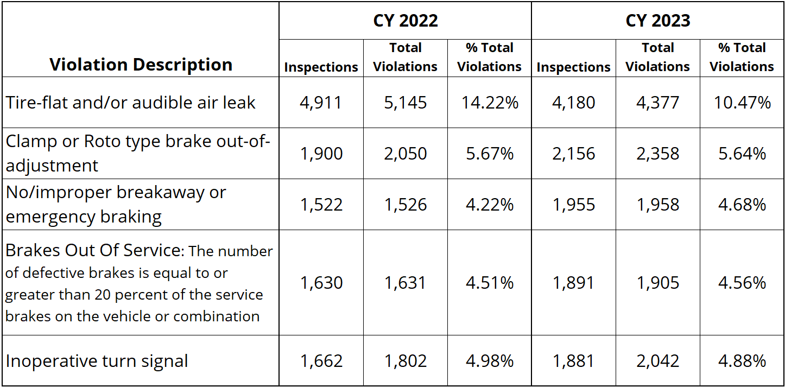
CY 2023 Top 5 Vehicle Violations
Notes:
Data Source: FMCSA’s Motor Carrier Management Information System (MCMIS) data snapshot as of 1/26/2024, including current year-to-date information for CY 2024. The data presented above are accurate as of this date but are subject to updates as new or additional information may be reported to MCMIS following the snapshot date.

Slide 17
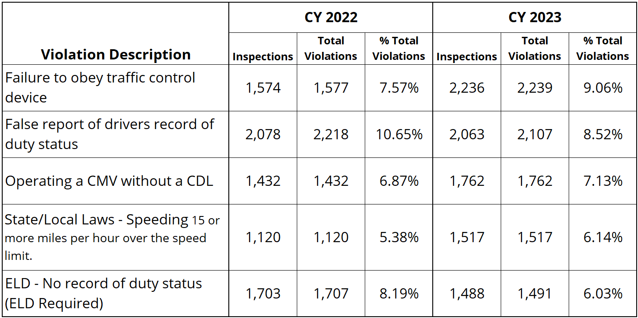
CY 2023 Top 5 Driver Violations

Slide 18
2023 CMV Violations
All Violations
Nearly half (49.78%) are equipment related
Driver Violations
More than 1 in 6 (16.87%) is related to fatigue
Nearly 1 in 6 (15.43%) is for speeding
More than 1 in 10 (10.61%) improperly licensed or NO CDL license
Notes:
Data Source: FMCSA’s Motor Carrier Management Information System (MCMIS) data snapshot as of 1/26/2024, including current year-to-date information for CY 2024. The data presented above are accurate as of this date but are subject to updates as new or additional information may be reported to MCMIS following the snapshot date.
Violations counted as “driver fatigue”
10/11 & 14/15 Hours
60/70/80 Hours
All Other Hours-of-Service
No RODS / RODS not current
State/Local Hours of Service

Slide 19
Contact Information
Dollena McHenry, PhD | Statistical Analyst
Tennessee Highway Patrol – TITAN Business Unit
Menzler-Nix Bldg.
1144 Foster Ave, Nashville, TN 37243
p. 615-743-3915
dollena.mcHenry@tn.gov

