Slide 1
Crash Prevention & Reduction
Chattanooga Area Safety Coalition Meeting
February 22, 2024

Slide 2
Federal Motor Carrier Safety Administration

Slide 3
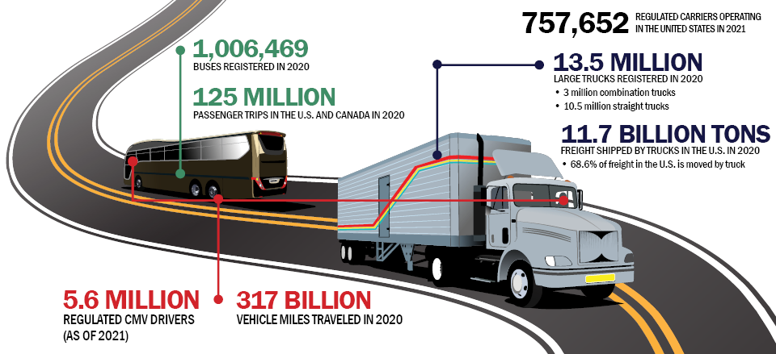
Snapshot of the CMV Industry

Slide 4
Total Fatalities in Large Truck and Bus Crashes and Fatal Crashes Involving Large Trucks or Buses
Source: National Highway Traffic Safety Administration (NHTSA), Fatality Analysis Reporting System (FARS)
*In 2016, NHTSA made changes to revise the light pickup truck classification and reclassified 329 vehicles as large trucks (based on gross vehicle weight rating). Due to this methodology change, comparisons of 2016 FARS large truck data with prior years should be performed with caution.

Slide 5
Crashes, Injuries, and Fatalities
MCMIS Safety Outcome | 2020 | 2021* | 2022*
Crashes Involving Large Trucks | 147,005 | 171,439 | 168,341
Injuries | 68,715 | 80,870 | 76,189
Fatalities | 4,987 | 5,787 | 5,371
*States are expected to report crash data to FMCSA within 90 days of the crash. Data are considered preliminary for 22 months to allow for changes.
Source: Motor Carrier Safety Progress Report (as of 9/30/2023): https://www.fmcsa.dot.gov/safety/data-and-statistics/motor-carrier-safety-progress-reports

Slide 6
National Roadway Safety Strategy (NRSS)
U.S. DOT’s comprehensive approach to significantly reducing serious injuries and deaths on our Nation’s highways, roads, and streets.
Sets a Department-wide vision and goal
Adopts the Safe System Approach
Identifies new priority actions and notable changes to existing practices
Leverages new funding and policies in the Bipartisan Infrastructure Law to bring this strategy to life
Calls others to action

Slide 7
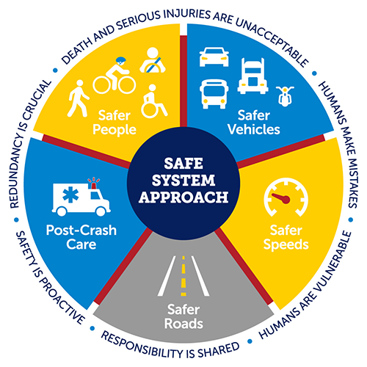
Zero Roadway Fatalities is Our Goal
DOT adopts the Safe System Approach as the guiding paradigm to address roadway safety.
Death and serious injuries are unacceptable.
Humans make mistakes.
Humans are vulnerable.
Responsibility is shared.
Safety is proactive.
Redundancy is crucial.
Objectives of a Safe System Approach
Safer People, Safer Vehicles, Safer Speeds,
Safer Roads, Post-Crash Care

Slide 8
What Can FMCSA Do Differently?
Call to action for crash reduction
Collaboration with all stakeholders to address crash reduction
Community-based approaches to drive down crash rates
Safety Campaigns
CMV Technology

Slide 9
Our Roads, Our Safety Campaign
National safety campaign to encourage road users to share the road safely with large trucks and buses.
Outreach Toolkit
Shareable graphics, Voices of Safety videos, tips and factsheets, talking points
https://www.fmcsa.dot.gov/ourroads

Slide 10
Your Roads. Their Freedom.
Human traffickers use America’s transportation systems to facilitate unimaginable crimes.
National Human Trafficking Hotline
1-888-373-7888 or text 233733 or BEFREE
FMCSA Campaign Resources on Human Trafficking
Indicator Cards
Posters
Shareable Social Media Graphics
Digital Screen Graphic
Ready-to-Use Newsletter Content
https://www.fmcsa.dot.gov/stophumantrafficking

Slide 11
Contact Information
Stephanie Mann | Division Administrator
Federal Motor Carrier Safety Administration | Tennessee Division
640 Grassmere Park, Suite 111 | Nashville, TN 37211
615-781-5782 | stephanie.mann@dot.gov
https://www.fmcsa.dot.gov/

Slide 12
Thank You!

