Slide 1
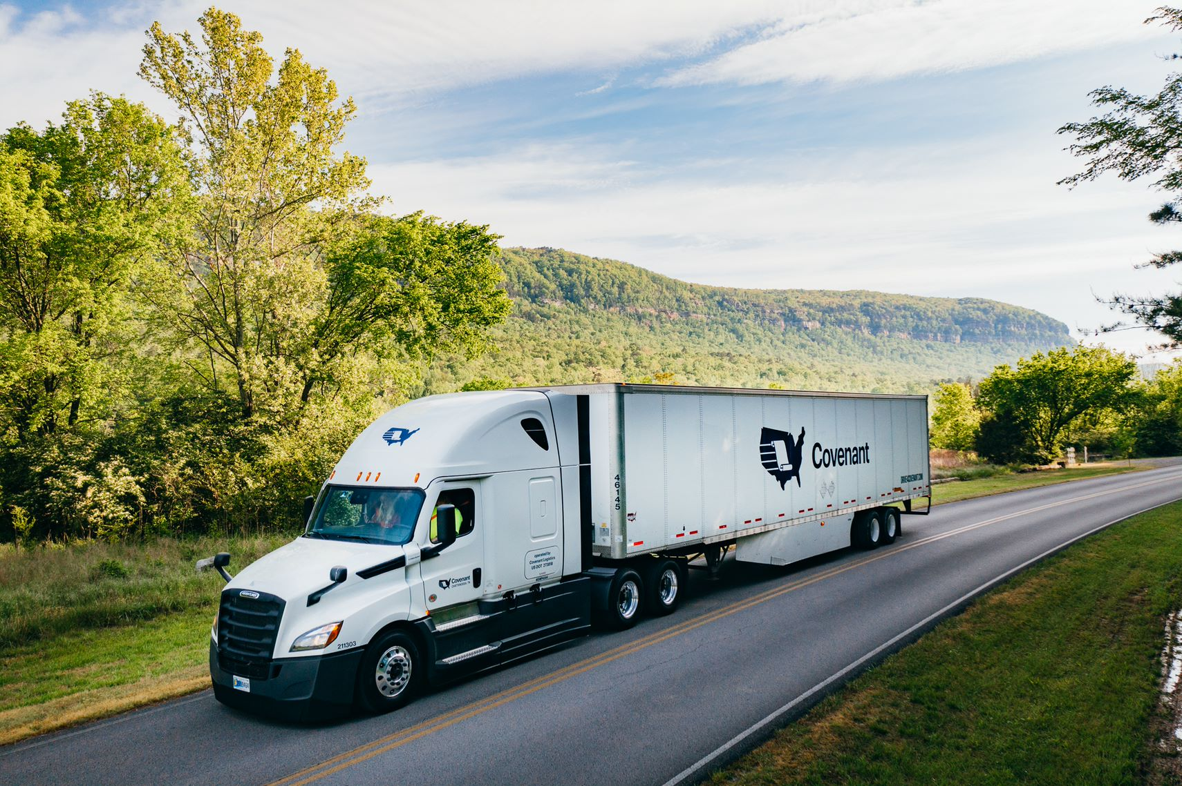
Welcome

Slide 2
Company Overview

Slide 3
Our Story: 36 Years Of History
Covenants Beginnings
In 1986, David Parker and his wife Jacqueline had a vision to start their own trucking company. David and Jacqueline Parker invested their hard-earned seed money to start Covenant Transport, with 25 trucks and 50 trailers.
Notes:
Covenant has grown through very strategic acquisitions. The first being SRT in 1998 then Star.In 2011 Covenant became 49% owner in Transport Enterprise Leasing, a organization that leases eequipment to drivers, In 2018 we acquired Landair which allowed us to be more ingrained in the dedicated and warehouse industry. Most recent we purchased AAT that allowed us to enter into the DOD sector of transportation.

Slide 4
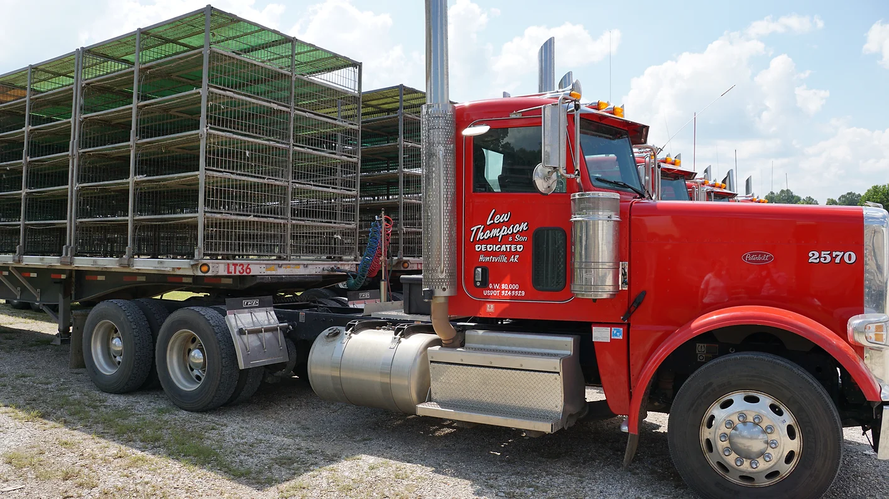
Our Story: 36 Years Of History
2023 Acquisition:
Notes:
Covenant has grown through very strategic acquisitions. The first being SRT in 1998 then Star.In 2011 Covenant became 49% owner in Transport Enterprise Leasing, a organization that leases eequipment to drivers, In 2018 we acquired Landair which allowed us to be more ingrained in the dedicated and warehouse industry. Most recent we purchased AAT that allowed us to enter into the DOD sector of transportation.

Slide 5
Logistics solutions
MANAGED TRANSPORTATION
DISTRIBUTION
CENTER MANAGEMENT
DEDICATED
CONTRACT CARRIAGE
EXPEDITED
TRANSPORTATION
Managed transportation
Capacity solutions
Supply chain visibility
Order fulfillment
Facility management
Inventory management
Dedicated fleet & drivers
Private fleet conversion
Continuous move
Just-in-time freight
Long-haul freight
High-value services
Notes:
Primary Takeaway: Covenant is a logistics company, primarily focused on growing our Distribution Center Management, Managed Transportation, and Dedicated Contract Carriage solutions.
Covenant’s primary solutions include Managed Transportation, Distribution Center Management, Dedicated Contract Carriage, and Expedited Transportation services.
DCC represents about 35% of our business and is a service we’ve provided since 1981. We manage fleets that range in size from 5 trucks to 200 trucks, and span multiple locations and types. Our DCC offerings include Dry Van, special equipment – high cube, light weight, heavy weight, haz mat and drayage include requirements for drivers with TWIC cards. All of our trucks are ELD compliant with satellite-based tracking.
Distribution Center Management represents about 10% of our solution set, and is a significant component of our business model. We manage close to 3 million square feet of warehouse for customers today. Our experience includes inbound warehouse management supporting the manufacturing process, value-add kitting and final assembly, finished goods distribution and service parts warehousing.
Managed Transportation is a rapidly growing component of our business model and is about 23% of our reported revenue. Through this solution, Covenant manages all common carrier freight (small package, LTL and TL) through our TMS solution. We negotiate carrier contracts, manage relationships with the carriers, perform detailed network wide planning sessions, fully execute all loads (tender through delivery), and audit and pay carrier invoices.
Expedited Transportation is the service on which Covenant was founded. Fortune 500 companies rely on the high-quality, time-sensitive delivery of the team-truck service. With over 750 tractors, Covenant is one of the largest providers of Expedited Transportation service in the U.S.

Slide 6
Our Culture
We’ve worked diligently throughout our history to foster a living, breathing culture of shared core values among our 5,000-plus associates.
EMPATHY
SERVANTHOOD
VIRTUE
Practicing Integrity, honesty and fairness in all situations.
To encourage individual accountability and prioritize the needs of the customer.
Treat others how you want to be treated.
Put others before yourself.
Notes:
David to begin our portion of the presentation focused on our family culture along with our 3 pillars – Empathy, Servanthood, and Virtue

Slide 7
Safety Program

Slide 8
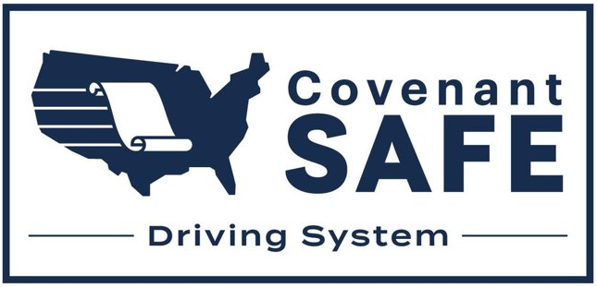
Zero Incident Mindset
This safety program was developed to address driver safety from a holistic behavior model that outlines:
Driving behaviors
Preventative lifestyle actions
Covenant Safety Culture

Slide 9
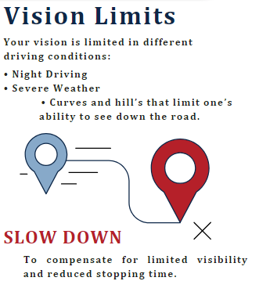
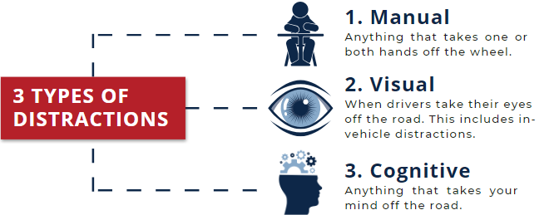

Slide 10
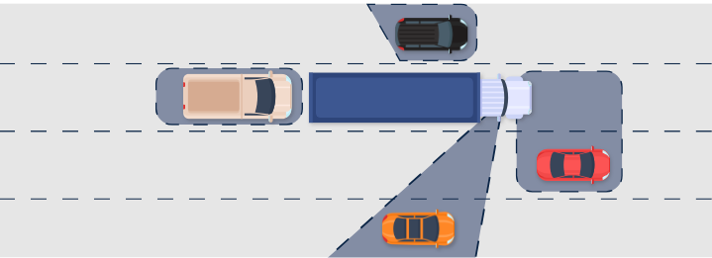

Slide 11
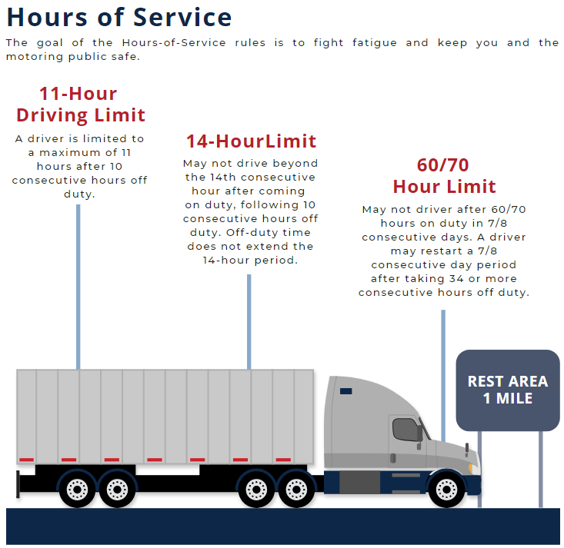

Slide 12
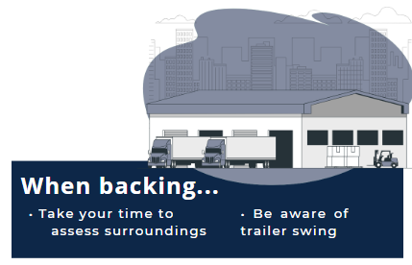
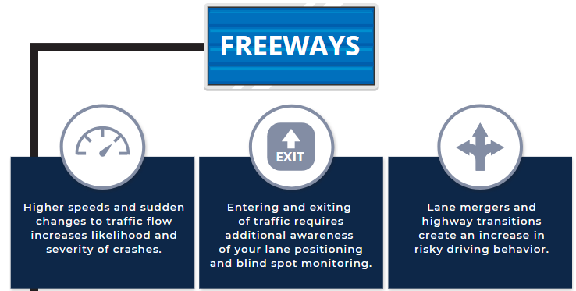

Slide 13
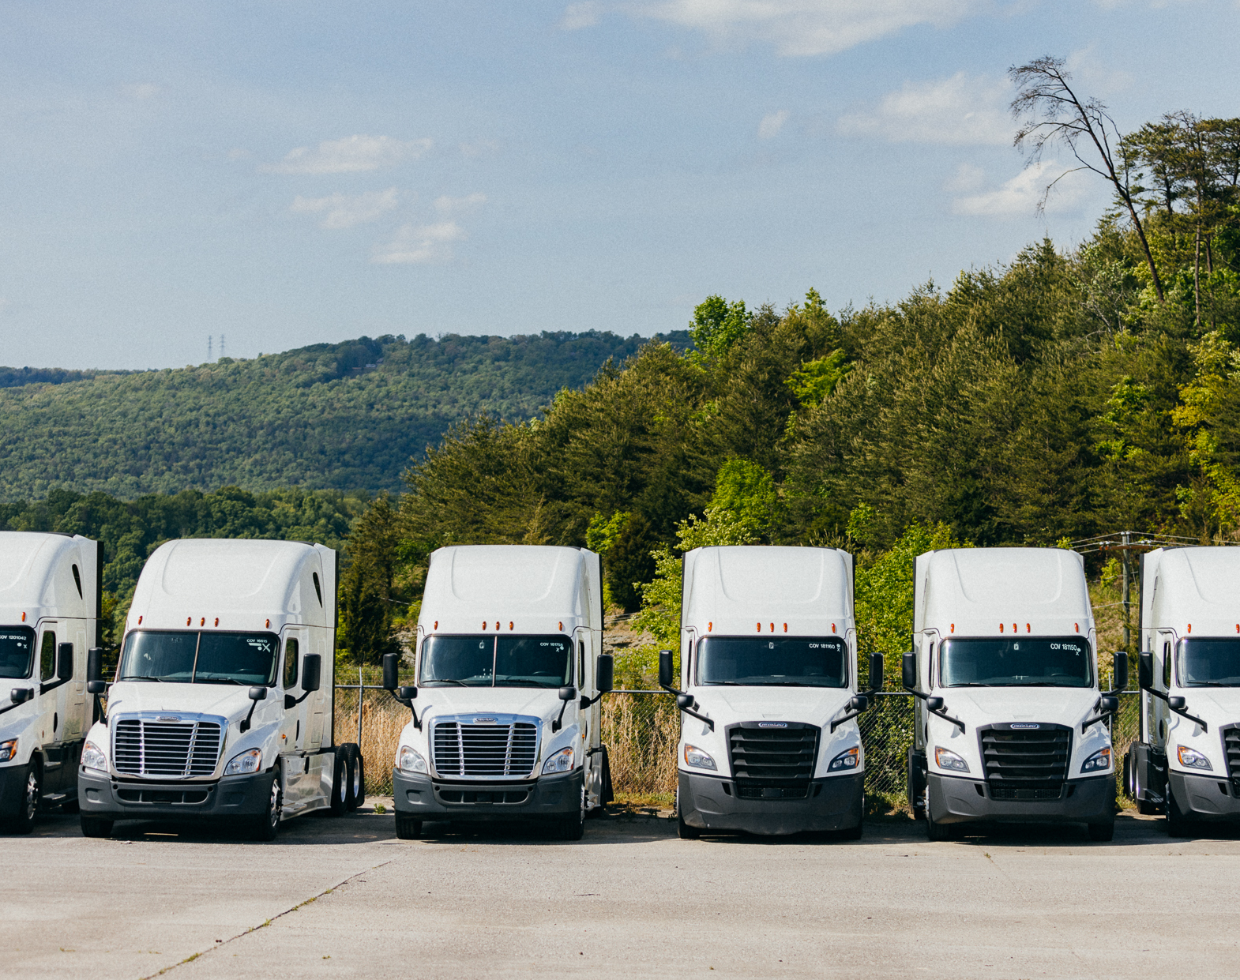
Safety Takeaways
The importance of branding
Connectivity between Safety and other departments
Integration of policy and procedures
Training to Learn

Slide 14
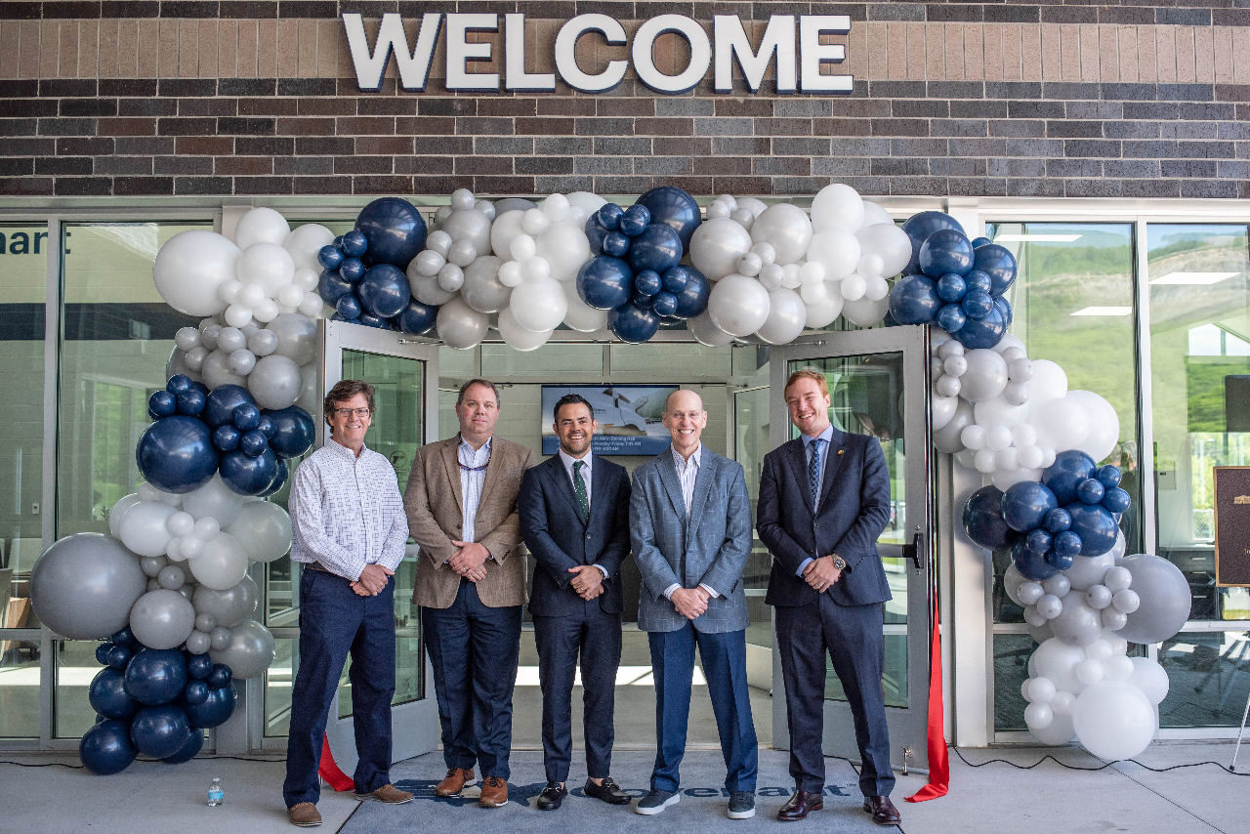
Facility and Driving Course Tour

